Slide 1



MPI + OpenMP tutorial
February 9th, 2018
Presenters:
TBD

Slide 2



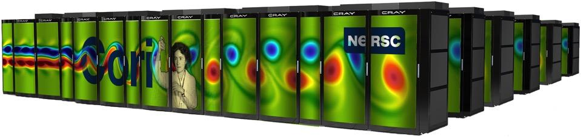

DOE’s Office of Science Computation User Facilities
DOE is leader in open High-Performance Computing
Provide the world’s most powerful computational tools for open science
Access is free to researchers who publish
Boost US competitiveness
Attract the best and brightest researchers
Helen note: changed Edison to Cori. Does Mira need to be changed to Theta?
NERSC
Cori is 32 PF
ALCF
Mira is 10 PF
OLCF
Titan is 27 PF
Notes:
DOE is leader in HPC
8 of 14 fastest computers in the world
EVERY US #1 computer has been at a DOE laboratory

Slide 3
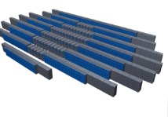
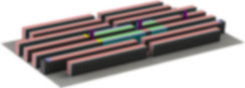
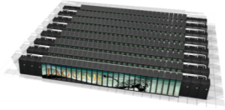

Roadmap to Exascale (ORNL)
Since clock-rate scaling ended in 2003, HPC performance has been achieved through increased parallelism. Jaguar scaled to 300,000 CPU cores. | Titan and beyond deliver hierarchical parallelism with very powerful nodes. MPI plus thread level parallelism through OpenMP or OpenACC plus vectors
OLCF5: 5-10x Summit
~20 MW
Summit: 5-10x Titan
Hybrid GPU/CPU
10 MW
Titan: 27 PF
Hybrid GPU/CPU
9 MW
Jaguar: 2.3 PF
Multi-core CPU
7 MW
CORAL System
2010
2012
2017
2022

Slide 4
Exascale Systems Roadmap (NERSC)
Helen note: added this slide
2010 | NERSC-6 | Hopper | Cray XE6 | 1.28 PF
2014 | NERSC-7 | Edison | Cray XC30 | 2.57 PF
2016 | NERSC-8 | Cori | Cray XC40 | 32 PF
2020 | NERSC-9 |  | Selection underway | ~100 PF
2024 | NERSC-10 |  |  | 1 EF
NERSC recommends MPI+OpenMP for N8 and N9 systems for programming model continuity and performance portability

Slide 5
Two Architecture Paths for Today and Future Leadership Systems
Power concerns for large supercomputers are driving the largest systems to either Heterogeneous or Homogenous (manycore) architectures
Heterogeneous Systems (e.g. Titan, Summit)
CPU(s) / GPU(s)
Likely to have (remove?) multiple CPUs and GPUs per node.
Small number of very powerful nodes
Expect (change?) data movement issues to be much easier than previous systems – coherent shared memory within a node
Multiple levels of memory – on package, DDR, and non-volatile
Homogenous (e.g. Sequoia/Mira/Theta/Cori)
10’s of thousands of nodes with millions of cores
Homogeneous cores
Multiple levels of memory – on package, DDR, and non-volatile (is this there for Sequoia and Mira? Cori does not have this)
Processors are self hosted
Helen note: added Theta and Cori behind Sequoia/Mira
Also changed last sentence of “unlike prior generations, future products are likely self-hosted”. Please check

Slide 6
System Attributes | NERSC | OLCF | ALCF | NERSC | ALCF | OLCF
Name | Edison | Titan | Mira | Cori | Theta | Summit
System peak (PF) | 2.57 | 27 | 10 | Haswell: 2.81 KNL: 29.5 | > 8.5 Update? | 200
Peak Power (MW) | 1.9 | 9 | 4.8 | 4.2 | 1.7 | 13.3
Total system memory | 357 TB Helen note: updated NERSC Edison and Cori info | 710TB | 768 TB Please check if Mira and Theta need updates too. | Haswell: 298.5 TB DDR4 KNL: 1.06 PB DDR4 + High Bandwidth Memory | >480 TB DDR4 + High Bandwidth Memory (HBM) | >2.4 PB DDR4 HBM2 PB persistent memory
Node performance (TF) | 0.461 | 1.452 | 0.204 | Haswell: 1.178 KNL: 3.046 | >3 Update? | >40
Node Processors | Intel Ivy Bridge | AMD Opteron NVIDIA K20x | 64-bit PowerPC A2 | Intel Haswell Intel KNL | Intel KNL Are there other type of nodes? | 2 Power9 6 NVIDIA Volta GPUs
System Size (nodes) | 5,586 nodes | 18,688 nodes | 49,152 | Haswell; 2,388 nodes KNL: 9,688 nodes | >2500 nodes Update? | ~4600 nodes
System Interconnect | Aries | Gemini | 5D Torus | Aries | Aries | Dual Rail EDR-IB
File System | 7.6 PB 168 GB/s Lustre | 32 OB 1 TB/s Lustre | 26 PB 300 GB/s GPFS | 28 PB >700 GB/s Lustre | 28 PB 744 GB/s Lustre | 120 PB 1 TB/s GPFS

Slide 7
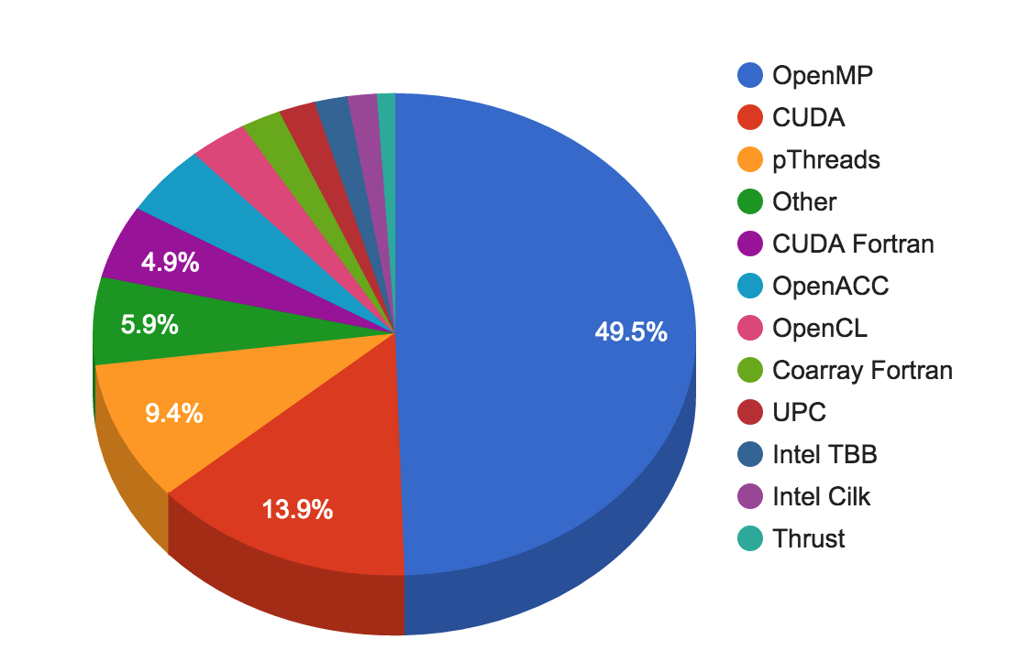
On Modern HPC systems, we need a solution to enable parallelism across nodes
Helen note: I think this slide can be combined with the next slide
MPI was developed primarily for inter-address space (inter means between or among)
OpenMP was developed for shared memory or intra-node, and now supports accelerators as well (intra means within)
Several solutions including
MPI + OpenMP
MPI + MPI
MPI + other languages
Non-MPI solutions such as HPX
Hybrid Programming is when we use a solution with different programming models for inter vs intra-node parallelism
Recall NERSC data from 2015:
When asked: If you use MPI + X,
what is X ?

Slide 8
Choices for Programming Models
Helen note: I think this slide can be combined with the previous slide
Pure MPI (one MPI process on each core)
Hybrid: MPI + X
Shared memory (OpenMP)
Accelerator programming (OpenMP 4.5 shared memory + offload, CUDA, etc)
Other
MPI message passing + MPI shared memory
PGAS: UPC/UPC++, CAF, GA, etc
Runtime tasks
MPI + OpenMP tend to be slower than pure MPI
Why? Many factors affect this

Slide 9
Choice of Programming Models
Helen note: This is the combined slide from previous two slides
MPI was developed primarily for inter-address space (inter means between or among)
OpenMP was developed for shared memory or intra-node, and now supports accelerators as well (intra means within)
Hybrid Programming (MPI+X) is when we use a solution with different programming models for inter vs. intra-node parallelism
Several solutions including
Pure MPI
MPI + Shared Memory (OpenMP)
MPI + Accelerator programming
OpenMP 4.5 shared memory + offload, CUDA, etc
MPI message passing + MPI shared memory
PGAS: UPC/UPC++, CAF, GA, etc
Runtime tasks (check)
Other Non-MPI solutions such as HPX (check)
NERSC data from 2015:
When asked: If you use MPI + X,
what is X ?
Helen note: need to check above whether HPX
is considered as Runtime tasks

Slide 10
Programming Model: MPI + OpenMP
Helen note: I think this slide can be removed
Efficient programming for clusters of shared memory nodes
Hierarchical system layout
Parallelism across nodes, within node (threads, simd, accelerators)
Hybrid programming
MPI between nodes
Shared memory programming inside the node
OpenMP
MPI-3 shared memory
Accelerator support in OpenMP

Slide 11
MPI and OpenMP
Helen note: I think this slide can be removed
Pure MPI Pro
Portable to distributed and shared memory machines
Scales beyond one node
No data placement problem
Pure MPI Cons
Difficult to developed and debug
High latency, low bandwidth
Explicit communication
Large granularity
Difficult load balancing
Pure OpenMP pros
Easy to implement parallelism
Low latency, high bandwidth
Implicit communication
Coarse and fine granularity
Dynamic load balancing
Pure OpenMP Cons
Only on shared memory systems
Scale within one node
Possibly data locality problem
No specific thread order

Slide 12
Why Hybrid MPI + OpenMP?
Homogenous and Heterogeneous systems have large core counts per node
Cori: Xeon Phi (KNL) 68 cores, 4 hardware threads per core. Total of 272 threads per node
Summit: Total 176 (SMT4) Power9 threads + 6 Volta GPUs per node
Application likely to run with MPI but not with good performance
Needs hybrid programming to manage threading, improve SIMD, accelerator programming
Many applications will not fit into the node memory using Pure MPI (e.g. per core) because of the memory overhead for each MPI task
Hybrid MPI/OpenMP is the recommended programming model to achieve scaling capability and code portability, new trend
Incremental parallelism with OpenMP for cores and accelerators
Some applications have two levels of parallelism naturally
Avoids extra communication overhead within the node
Adds fine granularity (larger message sizes) and allows increased dynamic load balancing across MPI tasks

Slide 13
Slides added: MPI + OpenMP Programming Styles
These set of slides need to talk about:
Introducing the hybrid programming styles
Give short examples

Slide 14
A Pseudo Hybrid MPI/OpenMP Code
Program hybrid
call MPI_INIT_THREAD (required, provided, ierr)
call MPI_COMM_RANK (…)
call MPI_COMM_SIZE (…)
… some computation and MPI communication
call OMP_SET_NUM_THREADS(4)
!$OMP PARALLEL DO PRIVATE(i)
!$OMP& SHARED(n)
do i=1,n
… computation
enddo
!$OMP END PARALLEL DO
… some computation and MPI communication
call MPI_FINALIZE (ierr)
end

Slide 15
Supported Levels of Thread Safety
Defined by MPI standard in the form of commitments that the multithreaded application makes to the MPI implementation. Not specific to hybrid MPI/OpenMP.
Use MPI_INIT_THREAD (required, provided, ierr), as an alternative to MPI_INIT (ierr)
IN: “required”, desired level of thread support (integer)
OUT: “provided”, provided level of thread support (integer)
Returned “provided” maybe less than “required”
Thread support levels:
MPI_THREAD_SINGLE: Only one thread will execute.
MPI_THREAD_FUNNELED: Process may be multi-threaded, but only master thread will make MPI calls (all MPI calls are ’’funneled'' to master thread)
MPI_THREAD_SERIALIZED: Process may be multi-threaded, multiple threads may make MPI calls, but only one at a time: MPI calls are not made concurrently from two distinct threads (all MPI calls are ’’serialized'').
MPI_THREAD_MULTIPLE: Multiple threads may call MPI, with no restrictions.

Slide 16
Hybrid MPI+OpenMP Programming Styles
MPI
MPI + OpenMP
OpenMP Only
Hybrid MPI +
MPI-3 (Shared Memory)
No overlap of Communication and Computation
Overlapping Communication and Communication
Material
Not covered
Master only
(outside omp parallel regions)
All threads call MPI
(inside omp parallel region)
Single Thread call MPI
(inside omp parallel region)
MPI_THREAD_SINGLE
MPI_THREAD_MULTIPLE
MPI_THREAD_FUNNELED
MPI_THREAD_SERIALIZLED
Offload to Accelerator(s) – (if available)
(e.g. OpenMP target regions, CUDA)

Slide 17
What This Means in the OpenMP Context
MPI_THREAD_SINGLE
No OpenMP multithreading in the program.
MPI_THREAD_FUNNELED
All of the MPI calls are made by the master thread i.e., all MPI calls are
Outside OpenMP parallel regions, or
Inside OpenMP master regions, or
Guarded by call to MPI_Is_thread_main MPI call.
(same thread that called MPI_Init_thread)
MPI_THREAD_SERIALIZED
#pragma omp parallel
…
#pragma omp critical{
…MPI calls allowed here…}
MPI_THREAD_MULTIPLE
Anything goes; any thread may make an MPI call at any time
Helen note: I think this slide can be removed
Notes:
There are no threads in the system
♦ E.g., there are no OpenMP parallel regions

Slide 18
Thread Support Levels
environment variable MPICH_MAX_THREAD_SAFETY | thread support level
not set | MPI_THREAD_SINGLE
single | MPI_THREAD_SINGLE
funneled | MPI_THREAD_FUNNELED
serialized | MPI_THREAD_SERIALIZED
multiple | MPI_THREAD_MULTIPLE
Different compilers may have different max level of thread support.
Make sure to set the environment variable in order to get the desired thread level. Otherwise, you may get a lower level than desired even if the compiler supports it.

Slide 19
MPI Calls Inside OMP MASTER
MPI_THREAD_FUNNELED is required.
OMP MASTER does not include any barrier. If the application needs a barrier (e.g., to prevent race conditions between the buffer usage in the MPI call and some numerical buffer read or write in other threads) then explicit OMP BARRIERs may be needed.
Such barriers would imply that all other threads are sleeping while the master thread does MPI communication! (may not be able to saturate the inter-node bandwidth).
!$OMP BARRIER
!$OMP MASTER
call MPI_xxx(…)
!$OMP END MASTER
!$OMP BARRIER

Slide 20
MPI Calls Inside OMP SINGLE
MPI_THREAD_SERIALIZED is required.
OMP_BARRIER or an implicit barrier is needed at the beginning since OMP_SINGLE only guarantees synchronization at the end.
It also implies all other threads are sleeping while one thread does MPI communication! (may not be able to saturate the inter-node bandwidth).
!$OMP BARRIER
!$OMP SINGLE
call MPI_xxx(…)
!$OMP END SINGLE

Slide 21
Overlap Communication and Computation
Is a good strategy for improving performance
Use MPI inside parallel region with thread-safe MPI
Need at least MPI_THREAD_FUNNELED
Many “easy” hybrid programs only need MPI_THREAD_FUNNELED
Simplest and least error-prone way is to use MPI outside parallel region, and allow only master thread to communicate between MPI tasks.
While this single master is making MPI calls, other threads are computing
Must be able to separate codes that can run before or after ghost zone or halo info is received. Can be very hard conceptually
May lose compiler optimizations such as vectorization
!$OMP PARALLEL
if (my_thread_rank < 1) then
call MPI_xxx(…)
else
do some computation
endif
!$OMP END PARALLEL

Slide 22
Best Practices for hybrid MPI/OpenMP (1)
With sequential code, decompose with MPI first, then add OpenMP
Choose between fine grain or coarse grain parallelism implementation
Use profiling tools to find hotspots. Add OpenMP and check correctness incrementally
Parallelize outer loop and consider loop collapse, loop fusion or loop permutation to give all threads enough work, and to optimize thread cache locality. Use NOWAIT clause if possible
Minimize shared variables, minimize serial/critical/barrier sections
Reduce number of OpenMP parallel regions to reduce overhead costs.
Pay attention to load imbalance. If needed, try dynamic scheduling or implement own load balance scheme.

Slide 23
Best Practices for hybrid MPI/OpenMP (2)
Decide whether to overlap MPI communication with thread computation
Consider OpenMP TASKing
Consider nested OpenMP
Consider OpenMP SIMD for better vectorization
Experiment with different combinations of MPI tasks and number of threads per task. Less MPI tasks may not saturate inter-node bandwidth
Be aware of NUMA domains. Test different process and thread affinity options
Leave some cores idle on purpose, for memory capacity or bandwidth capacity

Slide 24
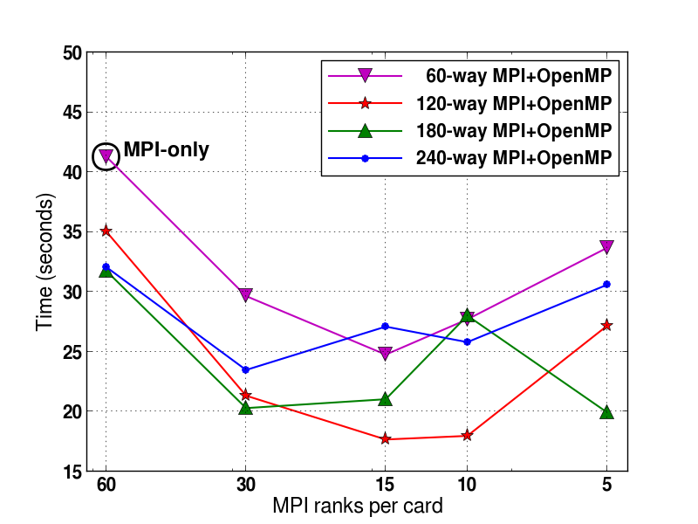
MPI vs. OpenMP Scaling Analysis for Optimal Configuration
Flash Kernel on Babbage
Each line represents multiple runs using fixed total number of cores = #MPI tasks x #OpenMP threads/task.
Scaling may depend on the kernel algorithms and problem sizes.
In this test case, 15 MPI tasks with 8 OpenMP threads per task is optimal.
Lower is Better
Courtesy of Chris Daley, NERSC
Find the sweet spot for hybrid MPI/OpenMP.

Slide 25
MPI + OpenMP: Affinity / Placement
These set of slides needs to talk about how to control affinity and placement

Slide 26
Thread Affinity and Data Locality
Process Affinity
Process Affinity: bind processes (MPI tasks, etc.) to CPUs
Thread Affinity: further binding threads to CPUs that are allocated to their parent process
Data Locality
Memory Locality: allocate memory as close as possible to the core on which the task that requested the memory is running
Cache Locality: reuse data in cache as much as possible
Correct process, thread and memory affinity is the basis for getting optimal performance

Slide 27
Memory Locality
Memory access in different NUMA domains are different
Accessing memory in remote NUMA is slower than accessing memory in local NUMA
Accessing High Bandwidth Memory on KNL is faster than DDR
OpenMP does not explicitly map data across shared memories
Memory locality is important since it impacts both memory and intra-node performance

Slide 28
OpenMP Thread Affinity
Helen note: this is a good slide. Oscar, is it yours or adapted from someone else’s please?
OpenMP provides a mechanism to map threads to hardware execution units (e.g. hardware threads, cores, sockets)
Its goal:
Maximize resource utilization
Minimize thread contention for the same hardware resource
Maximize local accesses and minimize remote memory accesses in NUMA
Develop strategies for memory latency programs vs. memory bandwidth bound
Cache reuse by threads
Bandwidth aggregation
Reduce thread synchronization overheads
Bind OpenMP threads to the hardware threads or cores

Slide 29
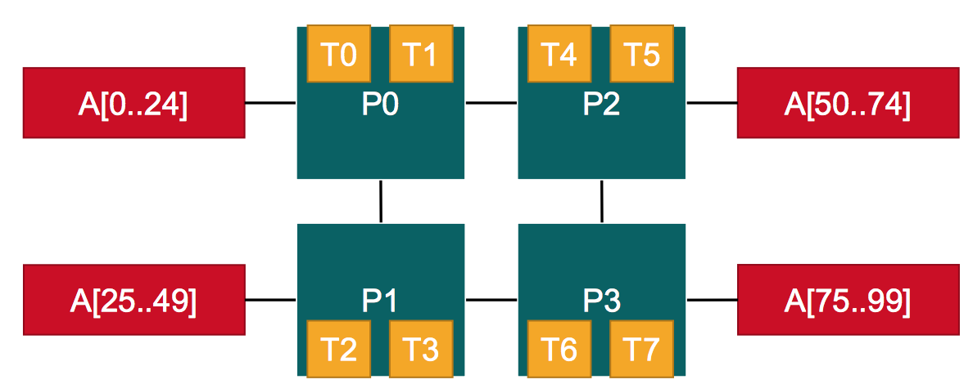
OpenMP Thread Affinity
Helen note: this is adapted by Oscar from RWTH Christian’s slide
Optimizing Thread Affinity depends on the target architecture and the application
How do hardware threads, cores and sockets lay out on the system and NUMA domains
How is data placed in the system
How is work scheduled to the threads
Hardware threads
NUMA domains
Data

Slide 30
OpenMP Thread Affinity
Helen note: This is a good slide we could use. Oscar, is this yours or adapted from someone else’s please?
Three main concepts:
Hardware
Abstraction
Mapping Strategy
OpenMP
Threads
OMP_PROC_BIND
Environment Variable
Or
proc_bind() clause
of parallel region
OMP_NUM_THREADS
Environment Variable
Or
num_threads() clause
of parallel region
OMP_PLACES
Environment Variable

Slide 31
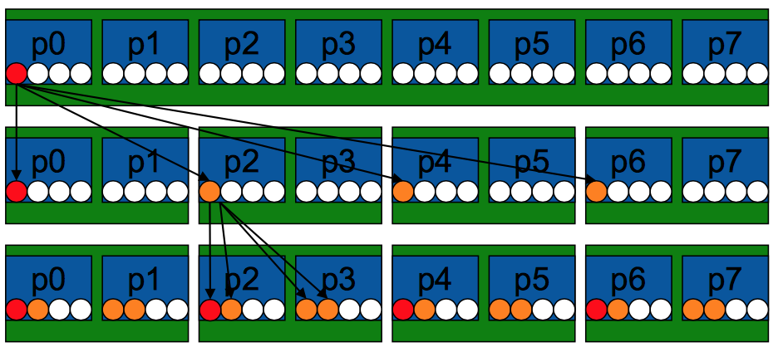
Thread Placement in OpenMP
Helen note: this slide can be removed. Covered in a later nested OpenMP illustration slide
Example’s Objective:
Separate cores for outer loop and near cores for inner loop
Outer Parallel Region: proc_bind(spread), Inner: proc_bind(close)
Spread creates partition, compact binds threads within respective partition
OMP_PLACES={0,1,2,3,}, {4,5,6,7}, … = {0:4}:8:4 = cores
#pragma omp parallel proc_bind(spread)
#pragma omp parallel proc_bind(close)
Example
intial
spread
close

Slide 32
Runtime Environment Variable: OMP_PROC_BIND
Controls thread affinity within and between OpenMP places
OpenMP 3.1 only has OMP_PROC_BIND, either TRUE or FALSE.
If true, the runtime will not move threads around between processors.
OpenMP 4.0 still allows the above. Added options:
close: bind threads close to the master thread
spread: bind threads as evenly distributed (spreaded) as possible
master: bind threads to the same place as the master thread
Examples:
export OMP_PROC_BIND=spread
export OMP_PROC_BIND=spread,close (for nested levels)

Slide 33
Considerations for OMP_PROC_BIND Choices
Helen note: this is adapted by Oscar from RWTH Christian’s slide
Selecting the “right” binding is dependent on the architecture topology but also on the application characteristics
Putting threads apart (e.g. different sockets)
can help to improve aggregated memory bandwidth
Combine the cache sizes across cores
May increase the overhead of synchronization across far apart threads
Putting threads near (e,g. hardware threads or cores sharing caches)
Good for synchronization and data reuse
May decrease total memory bandwidth

Slide 34
Runtime Environment Variable: OMP_PROC_BIND (2)
Prototype example: 4 cores total, 2 hyperthreads per core, OMP_NUM_THREADS=4
none: no affinity setting
close: Bind threads as close to each other as possible
spread: Bind threads as far apart as possible
master: bind threads to the same place as the master thread
Node | Core 0 |  | Core 1 |  | Core 2 |  | Core 3
 | HT1 | HT2 | HT1 | HT2 | HT1 | HT2 | HT1 | HT2
Thread | 0 | 1 | 2 | 3
Node | Core 0 |  | Core 1 |  | Core 2 |  | Core 3
 | HT1 | HT2 | HT1 | HT2 | HT1 | HT2 | HT1 | HT2
Thread | 0 |  | 1 |  | 2 |  | 3

Slide 35
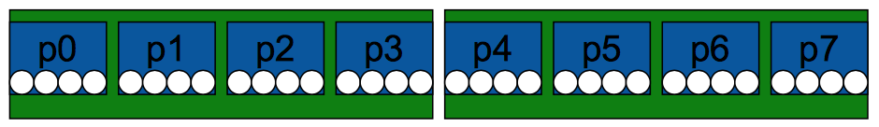
OpenMP Places – This slide needs to be improved
Helen note: this slide can be removed. Covered in a later slide
OpenMP places is an abstraction for a location where a thread or group of threads can run
Assume a machine with 2 sockets, 4 cores per socket, 4 hardware threads per core
A place can be mapped to a thread or set of hardware thread, core or sockets.
The user needs to define a set of places (or executing set of resources) where the OpenMP threads will be mapped to.

Slide 36
Runtime Environment Variable: OMP_PLACES (1)
OpenMP 4.0 added OMP_PLACES environment variable
Defines a series of places to which a thread or a group of threads can run
To control thread allocation
OMP_PLACES can be an abstract name or a specific list
threads: each place corresponds to a single hardware thread on the target machine.
cores: each place corresponds to a single core (having one or more hardware threads) on the target machine.
sockets: each place corresponds to a single socket (consisting of one or more cores) on the target machine.
A list with explicit CPU ids (see next slide)
Examples:
export OMP_PLACES=threads
export OMP_PLACES=cores

Slide 37
Abstract names for OMP_PLACES
Helen note: this slide can be removed. Covered in the previous OMP_PLACES slide
Threads – abstracts a single hardware thread on a node
Cores – abstracts a single core (which can have 1 or more hardware threads) on a node
Sockets – abstracts a single processors on the node

Slide 38
Runtime Environment Variable: OMP_PLACES (2)
OMP_PLACES can also be
A list with explicit place values of CPU ids, such as:
"{0,1,2,3},{4,5,6,7},{8,9,10,11},{12,13,14,15}”
“{0:4},{4:4},{8:4},{12:4}” (default stride is 1)
Format: {lower-bound:length:stride}. Thus, specifying {0:3:2} is the same as specifying {0,2,4}
Examples:
export OMP_PLACES=“ {0:4:2},{1:4:2}” (which is equivalent to “{0,2,4,6},{1,3,5,7}”)
export OMP_PLACES=“{0:8:1}” (which is equivalent to “{0,1,2,3,4,5,6,7}”

Slide 39
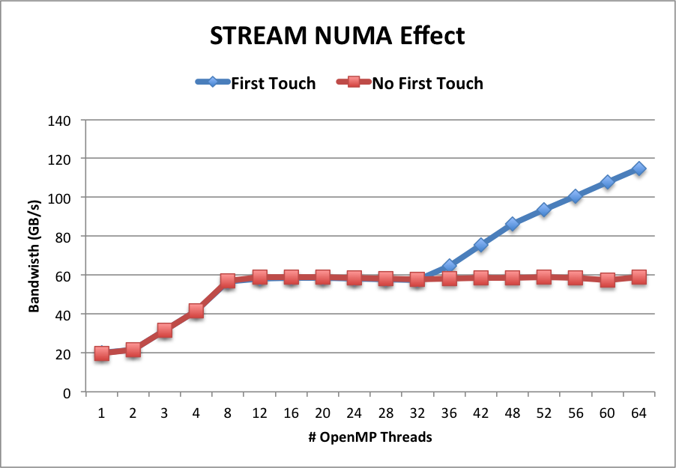
Memory Affinity: “First Touch” Memory
Step 1.1 Initialization
by master thread only
for (j=0; j<VectorSize; j++) {
a[j] = 1.0; b[j] = 2.0; c[j] = 0.0;}
Step 1.2 Initialization
by all threads
#pragma omp parallel for
for (j=0; j<VectorSize; j++) {
a[j] = 1.0; b[j] = 2.0; c[j] = 0.0;}
Step 2 Compute
#pragma omp parallel for
for (j=0; j<VectorSize; j++) {
a[j]=b[j]+d*c[j];}
Memory affinity is not defined when memory was allocated, instead it will be defined at initialization. Memory will be local to the thread which initializes it. This is called first touch policy.
Red: step 1.1 + step 2. No First Touch
Blue: step 1.2 + step 2. First Touch
OMP_PROC_BIND=close

Slide 40
“Perfect Touch” is Hard
Hard to do “perfect touch” for real applications
General recommendation is to use number of threads fewer than number of CPUs per NUMA domain
In the previous example, 16 cores (32 CPUs) per NUMA domain. Sample run options:
2 MPI tasks, 1 MPI task per NUMA domain, with 32 OpenMP threads (use hyperthreads) or 16 OpenMP threads (no hyperthreads) per MPI task
4 MPI tasks, 2 MPI tasks per NUMA domain, with 16 OpenMP threads (use hyperthreads) or 8 OpenMP threads (no hyperthreads) per MPI task
…

Slide 41
Other Runtime Environment Variables for Affinity Support
Helen note: this slide can be removed.
OMP_NUM_THREADS
OMP_THREAD_LIMIT
OMP_NESTED
OMP_MAX_ACTIVE_LEVELS
Names are upper case, values are case insensitive

Slide 42
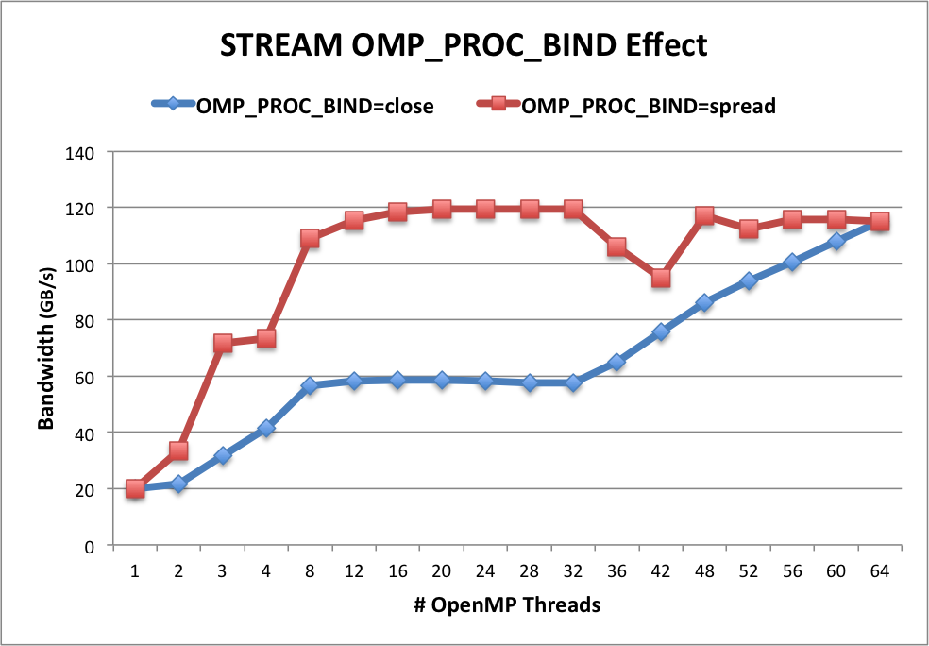
OMP_PROC_BIND Choices for STREAM
Blue: OMP_PROC_BIND=close
Red: OMP_PROC_BIND=spread
Both with First Touch
OMP_NUM_THREADS=32
OMP_PLACES=threads
OMP_PROC_BIND=close
Threads 0 to 31 bind to CPUs 0,32,1,33,2,34,…15,47. All threads are in the first socket. The second socket is idle. Not optimal.
OMP_PROC_BIND=spread
Threads 0 to 31 bind to CPUs 0,1,2,… to 32. Both sockets and memory are used to maximize memory bandwidth.

Slide 43
Sample Nested OpenMP Program
#include <omp.h>
#include <stdio.h>
void report_num_threads(int level)
{
#pragma omp single {
printf("Level %d: number of threads in the team: %d\n", level, omp_get_num_threads());
}
}
int main()
{
omp_set_dynamic(0);
#pragma omp parallel num_threads(2) {
report_num_threads(1);
#pragma omp parallel num_threads(2) {
report_num_threads(2);
#pragma omp parallel num_threads(2) {
report_num_threads(3);
}
}
}
return(0);
}
% a.out
Level 1: number of threads in the team: 2
Level 2: number of threads in the team: 1
Level 3: number of threads in the team: 1
Level 2: number of threads in the team: 1
Level 3: number of threads in the team: 1
% export OMP_NESTED=true
% export OMP_MAX_ACTIVE_LEVELS=3
% a.out
Level 1: number of threads in the team: 2
Level 2: number of threads in the team: 2
Level 2: number of threads in the team: 2
Level 3: number of threads in the team: 2
Level 3: number of threads in the team: 2
Level 3: number of threads in the team: 2
Level 3: number of threads in the team: 2
Level 0: P0
Level 1: P0 P1
Level 2: P0 P2; P1 P3
Level 3: P0 P4; P2 P5; P1 P6; P3 P7

Slide 44
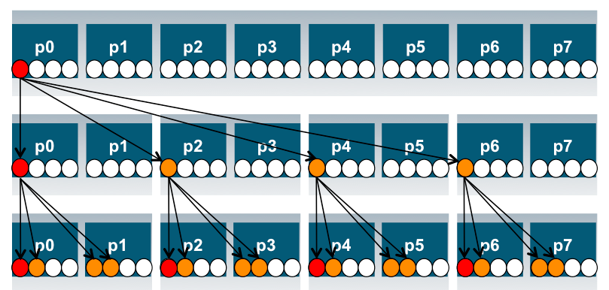
Process and Thread Affinity in Nested OpenMP
A combination of OpenMP environment variables and run time flags are needed for different compilers and different batch schedulers on different systems.
Use num_threads clause in source codes to set threads for nested regions.
For most other non-nested regions, use OMP_NUM_THREADS environment variable for simplicity and flexibility.
#pragma omp parallel proc_bind(spread)
#pragma omp parallel proc_bind(close)
initial
spread
Illustration of a system with:
2 sockets, 4 cores per socket,
4 hyper-threads per core
close
Example: Use Intel compiler with SLURM on Cori Haswell:
export OMP_NESTED=true
export OMP_MAX_ACTIVE_LEVELS=2
export OMP_NUM_THREADS=4,4
export OMP_PROC_BIND=spread,close
export OMP_PLACES=threads
srun -n 4 -c 16 --cpu_bind=cores ./nested.intel.cori

Slide 45
When to Use Nested OpenMP
Beneficial to use nested OpenMP to allow more fine-grained thread parallelism
Some application teams are exploring with nested OpenMP to allow more fine-grained thread parallelism
Hybrid MPI/OpenMP not using node fully packed
Top level OpenMP loop does not use all available threads
Multiple levels of OpenMP loops are not easily collapsed
Certain computational intensive kernels could use more threads
MKL can use extra cores with nested OpenMP
Nested level can be arbitrarily deep

Slide 46
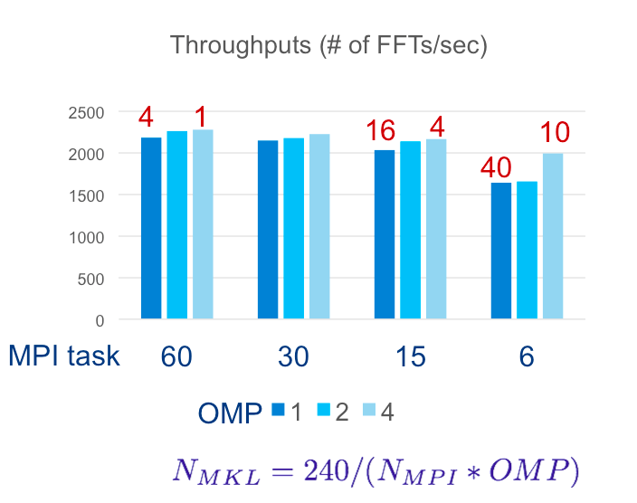
Use Multiple Threads in MKL
By Default, in OpenMP parallel regions, only 1 thread will be used for MKL calls.
MKL_DYNAMICS is true by default
Nested OpenMP can be used to enable multiple threads for MKL calls. Treat MKL as a nested inner OpenMP region.
Sample settings
export OMP_NESTED=true
export OMP_PLACES=cores
export OMP_PROC_BIND=sprad,close
export OMP_NUM_THREADS=6,4
export MKL_DYNAMICS=false
export OMP_MAX_ACTIVE_LEVELS=2
FFT3D on KNC, Ng=64³ example
Courtesy of Jeongnim Kim, Intel
*KNC: Intel® Xeon Phi™ processor (Knights Corner) … the first generation co-processor version of the chip.

Slide 47
Example: MPI + OpenMP affinity on Cori
Slides from Helen

Slide 48
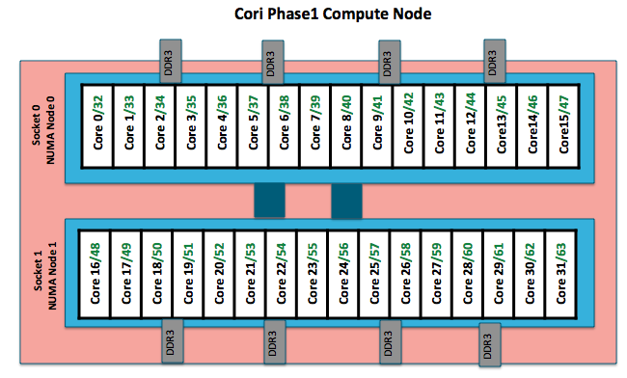
Cori: Example Compute Nodes (Intel Haswell)
An Intel Haswell node has 32 cores (64 CPUs), 128 MB DDR memory.
2 NUMA domains per node, 16 cores per NUMA domain. 2 hardware threads (CPUs) per core.
Memory bandwidth is non-homogeneous among NUMA domains.
CPUs 0-15, 32-47 are closer to memory in NUMA domain 0, farther to memory in NUMA domain 1.
CPUs 16-31, 48-64 are closer to memory in NUMA domain 1, farther to memory in NUMA domain 0.

Slide 49
numactl: Check Compute Node Information
numactl: controls NUMA policy for processes or shared memory
numactl -H: provides NUMA info of the CPUs
Cori Haswell node example
32 cores, 2 sockets
% numactl -H
available: 2 nodes (0-1)
node 0 cpus: 0 1 2 3 4 5 6 7 8 9 10 11 12 13 14 15 32 33 34 35 36 37 38 39 40 41 42 43 44 45 46 47
node 0 size: 64430 MB
node 0 free: 63002 MB
node 1 cpus: 16 17 18 19 20 21 22 23 24 25 26 27 28 29 30 31 48 49 50 51 52 53 54 55 56 57 58 59 60 61 62 63
node 1 size: 64635 MB
node 1 free: 63395 MB
node distances:node 0 1
0: 10 21
1: 21 10

Slide 50
CoriL KNL Node Overview
Helen note: Do we need this slide? We may put some into an “Extra Slides” section

Slide 51
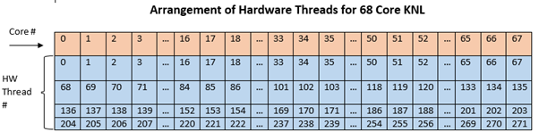
Cori: Example Compute Nodes (Intel KNL)
A Cori KNL node has 68 cores/272 CPUs, 96 GB DDR memory, 16 GB high bandwidth on package memory (MCDRAM).
Three cluster modes, all-to-all, quadrant, sub-NUMA clustering, are available at boot time to configure the KNL mesh interconnect.
A quad,cache node has only 1 NUMA node with all CPUs on the NUMA node 0 (DDR memory). The MCDRAM is hidden from the “numactl –H” result since it is a cache.
A quad,flat node has only 2 NUMA nodes with all CPUs on the NUMA node 0 (DDR memory). And NUMA node 1 has MCDRAM only.
A snc2,flat node has 4 NUMA domains with DDR memory and all CPUs on NUMA nodes 0 and 1. (NUMA node 0 has physical cores 0 to 33 and all corresponding hyperthreads, and NUMA node 1 has physical cores 34 to 67 and all corresponding hyperthreads). NUMA nodes 2 and 3 have MCDRAM only.

Slide 52
“numactl -H” displays NUMA domain info (1)
68-core Quad Cache node:
NUMA Domain 0: all 68 cores (272 logic cores)
yunhe@cori01:> salloc -N 1 --qos=interactive -C knl,quad,cache -t 30:00
salloc: Granted job allocation 5291739
yunhe@nid02305:> numactl -H
available: 1 nodes (0)
node 0 cpus: 0 1 2 3 4 5 6 7 8 9 10 11 12 13 14 15 16 17 18 19 20 21 22 23 24 25 26 27 28 29 30 31 32 33 34 35 36 37 38 39 40 41 42 43 44 45 46 47 48 49 50 51 52 53 54 55 56 57 58 59 60 61 62 63 64 65 66 67 68 69 70 71 72 73 74 75 76 77 78 79 80 81 82 83 84 85 86 87 88 89 90 91 92 93 94 95 96 97 98 99 100 101 102 103 104 105 106 107 108 109 110 111 112 113 114 115 116 117 118 119 120 121 122 123 124 125 126 127 128 129 130 131 132 133 134 135 136 137 138 139 140 141 142 143 144 145 146 147 148 149 150 151 152 153 154 155 156 157 158 159 160 161 162 163 164 165 166 167 168 169 170 171 172 173 174 175 176 177 178 179 180 181 182 183 184 185 186 187 188 189 190 191 192 193 194 195 196 197 198 199 200 201 202 203 204 205 206 207 208 209 210 211 212 213 214 215 216 217 218 219 220 221 222 223 224 225 226 227 228 229 230 231 232 233 234 235 236 237 238 239 240 241 242 243 244 245 246 247 248 249 250 251 252 253 254 255 256 257 258 259 260 261 262 263 264 265 266 267 268 269 270 271
node 0 size: 96762 MB
node 0 free: 93067 MB
node distances:
node 0
0: 10
The quad,cache mode has only 1 NUMA node with all CPUs on the NUMA node 0 (DDR memory)
The MCDRAM is hidden from the numactl –H command (it is a cache).

Slide 53
Cori: Intel KNL Quad,Flat Node
KNL quad,flat node: 68 cores (272 CPUs)
% numactl –H
available: 2 nodes (0-1)
node 0 cpus: 0 1 2 3 4 5 6 7 8 9 10 11 12 13 14 15 16 17 18 19 20 21 22 23 24 25 26 27 28 29 30 31 32 33 34 35 36 37 38 39 40 41 42 43 44 45 46 47 48 49 50 51 52 53 54 55 56 57 58 59 60 61 62 63 64 65 66 67 68 69 70 71 72 73 74 75 76 77 78 79 80 81 82 83 84 85 86 87 88 89 90 91 92 93 94 95 96 97 98 99 100 101 102 103 104 105 106 107 108 109 110 111 112 113 114 115 116 117 118 119 120 121 122 123 124 125 126 127 128 129 130 131 132 133 134 135 136 137 138 139 140 141 142 143 144 145 146 147 148 149 150 151 152 153 154 155 156 157 158 159 160 161 162 163 164 165 166 167 168 169 170 171 172 173 174 175 176 177 178 179 180 181 182 183 184 185 186 187 188 189 190 191 192 193 194 195 196 197 198 199 200 201 202 203 204 205 206 207 208 209 210 211 212 213 214 215 216 217 218 219 220 221 222 223 224 225 226 227 228 229 230 231 232 233 234 235 236 237 238 239 240 241 242 243 244 245 246 247 248 249 250 251 252 253 254 255 256 257 258 259 260 261 262 263 264 265 266 267 268 269 270 271
node 0 size: 96723 MB
node 0 free: 93924 MB
node 1 cpus:
node 1 size: 16157 MB
node 1 free: 16088 MB
node distances:
node 0 1
0: 10 31
1: 31 10
The quad,flat mode has only 2 NUMA nodes with all CPUs on the NUMA node 0 (DDR memory).
And NUMA node 1 has MCDRAM (high bandwidth memory).

Slide 54
A Naive “srun” Causes Mess in Process/Thread Affinity
Example: 16 MPI tasks x 8 OpenMP threads per task on a single 68-core KNL quad,cache node:
% export OMP_NUM_THREADS=8
% export OMP_PROC_BIND=spread (other choice are “close”,”master”,”true”,”false”)
% export OMP_PLACES=threads (other choices are: cores, sockets, and various ways to specify explicit lists)
% srun -n 16 ./xthi |sort -k4n,6n
Hello from rank 0, thread 0, on nid02304. (core affinity = 0)
Hello from rank 0, thread 1, on nid02304. (core affinity = 144) (on physical core 8)
Hello from rank 0, thread 2, on nid02304. (core affinity = 17)
Hello from rank 0, thread 3, on nid02304. (core affinity = 161) (on physical core 25)
Hello from rank 0, thread 4, on nid02304. (core affinity = 34)
Hello from rank 0, thread 5, on nid02304. (core affinity = 178) oin physical core 42)
Hello from rank 0, thread 6, on nid02304. (core affinity = 51)
Hello from rank 0, thread 7, on nid02304. (core affinity = 195) (on physical core 59)
Hello from rank 1, thread 0, on nid02304. (core affinity = 0)
Hello from rank 1, thread 1, on nid02304. (core affinity = 144)
It is a mess!

Slide 55
Cori KNL: the importance of “srun” -c and --cpu_bind Options
The reason is #MPI tasks is not divisible by 68!
Each MPI task is getting 68x4/#MPI tasks of logical cores as the domain size
MPI tasks are crossing tile boundaries
Let’s set number of logical cores per MPI task (-c) manually by wasting extra 4 cores on purpose, which is 256/#MPI tasks.
Meaning to use 64 cores only on the 68-core KNL node, and spread the logical cores allocated to each MPI task evenly among these 64 cores.
Now It looks good!
% srun -n 16 -c 16 --cpu_bind=cores ./xthi
Hello from rank 0, thread 0, on nid09244. (core affinity = 0)
Hello from rank 0, thread 1, on nid09244. (core affinity = 136) (on physical core 0)
Hello from rank 0, thread 2, on nid09244. (core affinity = 1)
Hello from rank 0, thread 3, on nid09244. (core affinity = 137) (on physical core 1)

Slide 56
Now it Looks good!
Helen note: this slide can be removed
Process/thread affinity are good! (Marked first 6 and last MPI tasks only)
0 | 1 | 2 | 3 | 4 | 5 | 6 | 7 | 8 | 9 | 10 | 11 | 12 | 13 | 14 | 15 | 16 | 17
68 | 69 | 70 | 71 | 72 | 73 | 74 | 75 | 76 | 77 | 78 | 79 | 80 | 81 | 82 | 83 | 84 | 85
136 | 137 | 138 | 139 | 140 | 141 | 142 | 143 | 144 | 145 | 146 | 147 | 148 | 149 | 150 | 151 | 152 | 153
204 |  |  |  |  |  |  |  |  |  |  |  |  |  |  |  | 220 | 221
18 | 19 | 20 | 21 | 22 | 23 | 24 | 25 | 26 | 27 | 28 | 29 | 30 | 31 | 32 | 33 | 34 | 35
86 |  |  |  |  |  |  |  |  |  |  |  |  |  |  |  | 102 | 103
154 | 155 | 156 | 157 | 158 | 159 | 160 | 161 |  |  |  |  |  |  |  |  | 170 | 171
222 |  |  |  |  |  |  |  |  |  |  |  |  |  |  |  | 238 | 239
36 | 37 | 38 | 39 | 40 | 41 | 42 | 43 | 44 | 45 | 46 | 47 | 48 | 49 | 50 | 51
104
172
240
52 | 53 | 54 | 55 | 56 | 57 | 58 | 59 | 60 | 61 | 62 | 63 | 64 | 65 | 66 | 67
120 |  |  |  |  |  |  |  |  |  |  |  |  |  |  | 135
188 |  |  |  |  |  |  |  | 196 | 197 | 198 | 199 | 200 | 201 | 202 | 203
256 |  |  |  |  |  |  |  |  |  |  |  |  |  |  | 271
And so on for other MPI tasks and threads ….

Slide 57
Cori: Essential Runtime Settings for Process/Thread Affinity
Use srun -c and --cpu_bind flags to bind tasks to CPUs
-c <n> (or --cpus-per-task=n) allocates (reserves) n CPUs per task (process). It helps to evenly spread MPI tasks
Use --cpu_bind=cores (no hyperthreads) or --cpu_bind=threads (if hyperthreads are used)
Use OpenMP envs, OMP_PROC_BIND and OMP_PLACES to fine pin each thread to a subset of CPUs allocated to the host task
Different compilers may have different default values for them
The following provide compatible thread affinity among Intel, GNU and Cray compilers:
OMP_PROC_BIND=true # Specifying threads may not be moved between CPUs
OMP_PLACES=threads # Specifying a thread should be placed in a single CPU
Notes:
There are multiple different ways to achieve the process/thread affinity. Eg., numactl –physcpubind=cpus. Compilers have thread affinity feature as well.
OMP_PORC_BIND – specifies whether threads may be moved between CPUs.
OMP_PLACES – Specifies on which CPUs the threads should be placed
OMP_DISPLAY_ENV: If set to TRUE, the OpenMP version number and the values associated with the OpenMP environment variables are printed to stderr.
Intel compiler sets OMP_PROC_BIND=intel by default for KNL (not for Haswell), which then “promotes” it to OMP_PROC_BIND=spread at execution time;
GNU and Cray compilers does not enable OMP_PROC_BIND by default.

Slide 58
Cori: Essential Runtime Settings for MCDRAM Memory Affinity
In quad,cache mode, no special setting is needed to use MCDRAM
In quad,flat mode, using quad,flat as an example
NUMA node 1 is MCDRAM
Enforced memory mapping to MCDRAM
If using >16 GB, malloc will fail
Use “numactl -m 1 ./myapp” as the executable (instead of “./myapp”)
Or add “--mem_bind=map_mem:1” to the srun options
Preferred memory mapping to MCDRAM:
If using >16 GB, malloc will spill to DDR
Use “numactl -p 1 ./myapp” as the executable (instead of “./myapp”)
Or add “--mem_bind=preferred:map_mem:1” to the srun options

Slide 59
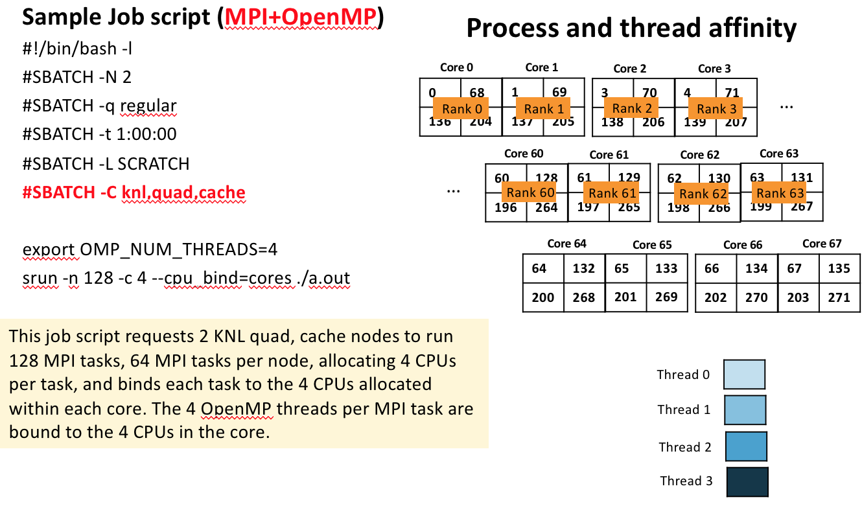
Cori: Sample Job Script to Run on KNL quad,cache Nodes

Slide 60
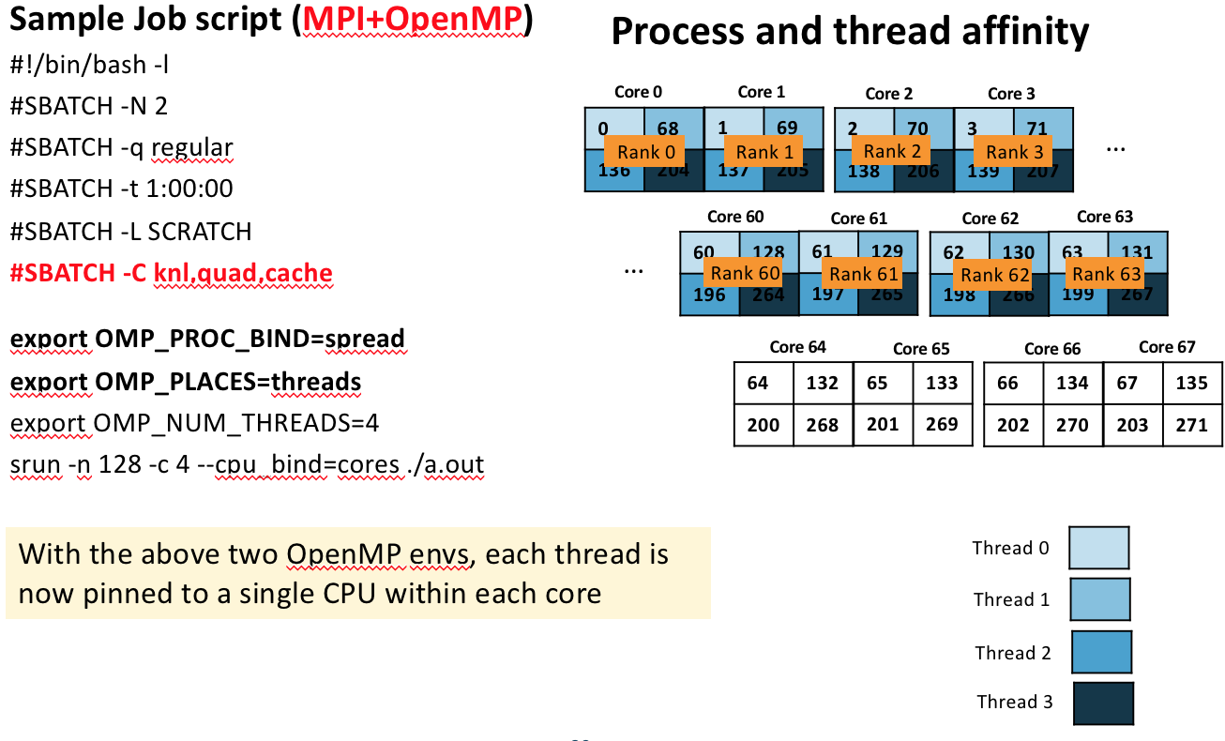
Cori: Sample Job Script to Run on KNL quad,cache Nodes
Notes:
There are multiple different ways to achieve the process/thread affinity. Eg., numactl –physcpubind=cpus. Compilers have thread affinity feature as well.
OMP_PORC_BIND – specifies whether threads may be moved between CPUs.
OMP_PLACES – Specifies on which CPUs the threads should be placed
OMP_DISPLAY_ENV: If set to TRUE, the OpenMP version number and the values associated with the OpenMP environment variables are printed to stderr.
Intel compiler sets OMP_PROC_BIND=intel by default for KNL (not for Haswell), which then “promotes” it to OMP_PROC_BIND=spread at execution time;
GNU and Cray compilers does not enable OMP_PROC_BIND by default.

Slide 61
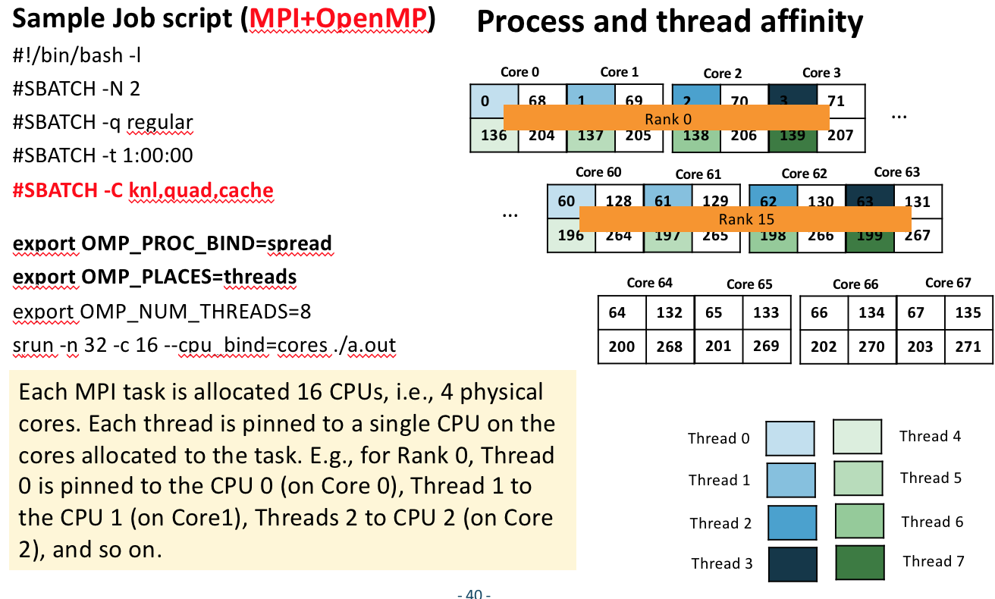
Cori: Sample Job Script to Run on KNL quad,cache Nodes

Slide 62
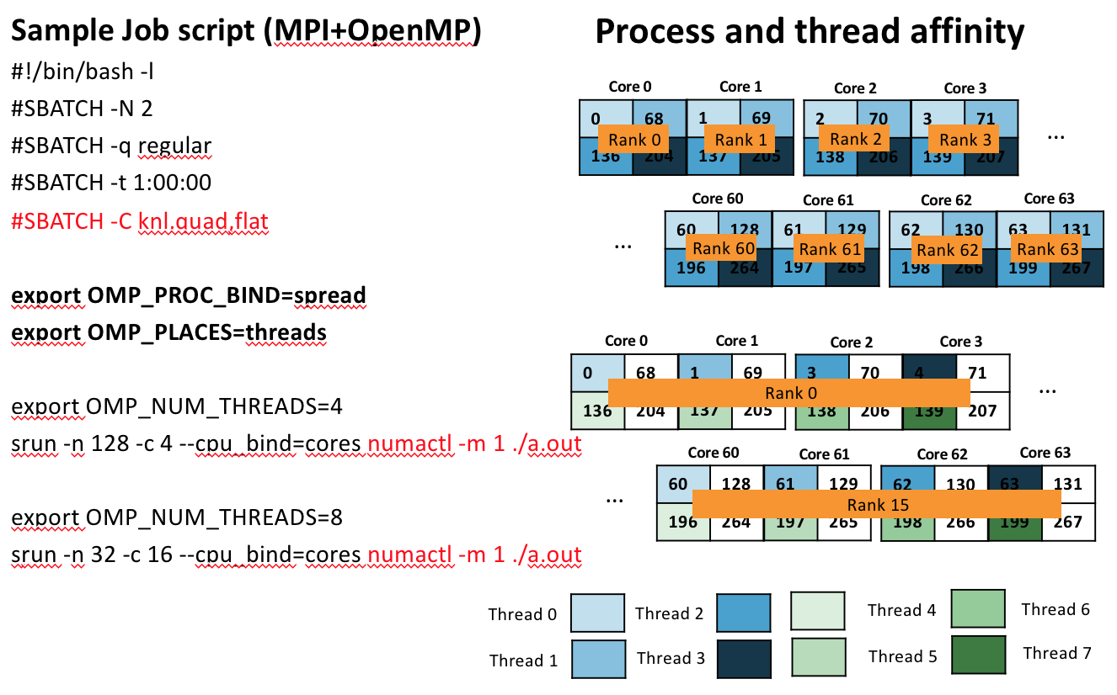
Cori: Sample Job Script to Run on KNL quad,flat Nodes

Slide 63
Thread Affinity and Data Locality Best Practices
Helen note: I think this slide can be removed
Achieving best data locality, and optimal process and thread affinity is crucial in getting good performance with OpenMP, yet it is not straightforward to do so
Understand the node architecture with tools such as “numactl -H” first
Always use simple examples with the same settings for your real application to verify first
Exploit first touch data policy, optimize code for cache locality
Pay special attention to avoid false sharing
Put threads far apart (spread) may improve aggregated memory bandwidth and available cache size for your application, but may also increase synchronization overhead. And putting threads “close” have the reverse impact as “spread”
For nested OpenMP, set OMP_PROC_BIND=spread,close is generally recommended
Use numactl -m or -p option to explicitly request memory allocation in specific NUMA domain (for example: high bandwidth memory in KNL)
*KNL: Intel® Xeon Phi™ processor 7250 with 68 cores @ 1.4 GHz

Slide 64
OpenMP MPI+OpenMP affinity on Summit
A Summit Node: cores, hardware threads and GPUs
Node characteristics:
2 POWER9 per node
22 cores per P9
4 hardware threads per core
6 Volta GPUs connected NVLINK2
Node Configuration:
2 cores reserved for OS
Applications will have 42 cores;
168 threads hardware threads
7 cores per GPU; 28 hw threads
per GPU
GPU
GPU
POWER 9
GPU
GPU
POWER 9
GPU
GPU
Core
Hardware thread (SMT4)

Slide 65
Summit – MPI+OpenMP Affinity
jsrun is used to launch MPI, MPI+OpenMP, OpenMP (only) applications
jsrun utility controls MPI task placement and OpenMP places
MPI+OpenMP affinity set by jsrun
MPI task placement
Sets OpenMP places ICV and environment variable
Sets one OpenMP place per hardware thread.
OpenMP thread binding is set by OMP_PROC_BIND or proc_bind() clause
mpirun is also available (not preferred)
For more information on jsrun:
https://beta.olcf.ornl.gov/for-users/system-user-guides/summit/running-jobs/

Slide 66
Summit - JSRUN – Resource Sets
A resource set
Controls how resources are managed within the node
Can create one ore more resource sets within a node
Each resource set contain 1 or more cores and 0 or more GPUs
Understand how the application interacts with the system
How many tasks/threads per GPU
Does each task expect to see a single GPU? (or multiple GPUs)
Create resource sets to specify:
GPUs per resource set
Cores per resource set
MPI tasks per resource set
Distribution
Decide the # of resource set needed in applications

Slide 67
Resources sets in Summit Node
A Summit Node: cores, hardware threads and GPUs
A resource set
GPU
Resource Set (example)
1 GPU
7 cores per P9
(28 Hardware Threads (SMT4))
Node resources
A node can have up to 6 resource sets of this type
MPI tasks are distributed across resource sets. Example:
1 MPI task per resource set
2 MPI tasks per resource set
Or with other distributions (cyclic)
GPU
POWER 9
GPU
GPU
POWER 9
GPU
GPU
Core
Hardware thread (SMT4)

Slide 68
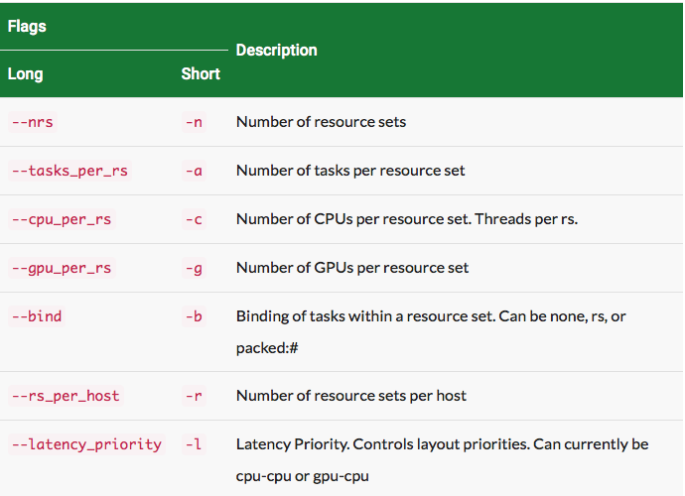
JSRUN Command
jsrun [ -n #resource sets ] [tasks, threads, and GPUs within a resource set] exec [ program args ]

Slide 69
Example of MPI+OpenMP Affinity (Dirac, GTC, HACC, NWCHEM)
1 MPI task per GPU and 28 OpenMP threads (hw threads – SMT4).
1 MPI task per GPU
NVIDIA Volta GPUs
GPU
MPI Task
OS
GPU
OpenMP thread
POWER 9
GPU
GPU
OS
POWER 9
GPU
GPU
jsrun --cpu_per_rs 7 --gpu_per_rs 1 … --np <# of tasks>
(default --latency_priority will CPU’s as close as possible to GPU)

Slide 70
Example of MPI+OpenMP Affinity (E3SM)
2 MPI task per GPU and 7 OpenMP threads (hw threads – SMT2).
2 MPI task access a GPU
NVIDIA Volta GPUs
GPU
MPI Task
OS
GPU
OpenMP thread
POWER 9
GPU
GPU
OS
POWER 9
GPU
GPU
No way to do this currently (involves splitting cpus)
closest: jsrun --cpu_per_rs 6 --gpu_per_rs 1 --nrs <x> --tasks_per_rs 2--launch_distribution plane:2 --bind packed:3

Slide 71
MPI+OpenMP: Affinity (LS-Dalton) / Tasking
1 MPI task per node and 42 OpenMP threads (SMT1).
One MPI task access all GPUs
NVIDIA Volta GPUs
1 MPI Task Access all GPUs
GPU
MPI Task
OS
GPU
POWER 9
OpenMP thread
GPU
GPU
OS
POWER 9
GPU
GPU
jsrun --cpu_per_rs ALL_CPUS --gpu_per_rs ALL_CPUS --bind rs --np <# of tasks>

Slide 72
Example of MPI+OpenMP Affinity (NAMD)
10 MPI task per 3 GPU and 8 OpenMP threads (hw threads – SMT4).
10 MPI tasks access 3 GPU (MPS)
NVIDIA Volta GPUs
GPU
OS
3 GPUs
MPI Task
GPU
OpenMP thread
POWER 9
GPU
GPU
OS
3 GPUs
POWER 9
GPU
GPU
jsrun --cpu_per_rs 20 --gpu_per_rs 3 --tasks_per_rs 10 --bind packed:2 --launch_distribution plane:10
Notes:
Tasks per GPU threads --- no --np???? – inconsistent?

Slide 73
Application Case Studies
Helen note: not an actual slide. Just list ideas
Cori. potential candidates, 1 to 3 pages each. Won’t use all!
CESM HOMME
Restructure OpenMP. Nested OpenMP
Overlap Computation and communication: mpi_thread_multiple. (Kevin)
OpenMP tasking (Bill biology code)
BoxLib (Nyx?) tilting and collapse. (Brian F, update?)
QE. move OpenMP into outer loops, collapse 2, manual blocking/tiling. (Thorsten)
VASP. Sweet spot scaling
OpenMP SIMD? (BGW)
MPAS. Scheduling ….
Titan
(Summit is to early)

Slide 74
CESM HOMME
High Order Method Modeling Environment (HOMME) is the atmospheric dynamical core for CESM and ACME.
35% of total CESM time
nested parallelism over elements and at loop-level, many small/medium-sized parallel regions
Original OpenMP Structure
140 OpenMP regions defined
OpenMP directives implemented at loop-level:
#if(defined HORIZ_OPENMP) !$omp parallel do private (...) #endif
and
#if(defined COLUMN_OPENMP) !$omp parallel do private (…) #endif
Number of threads defined in namelist: Nthreads=…

Slide 75
HOMME: Modified OpenMP Structure
OpenMP parallel regions defined outside of subroutine boundaries
Generalizes the OpenMP constructs
Significant reduction in number of OpenMP regions
OpenMP directives: !$omp parallel
call sub()
!$omp end parallel
Support threading in horizontal, vertical, and tracers OpenMP threading simultaneously
Code easier to maintain as “PRIVATE” OpenMP declarations are eliminated
Nested OpenMP
vertical_remap (outside):
call create_omp_region(‘horizontal’)
call omp_set_nested(.true.)
!$omp parallel
call set_omp_ranges(‘horizontal’)
call vertical remap(…)
!$omp end parallel
call omp_set_nested(.false.)
call reset_ranges(‘horizontal’)
vertical remap (inside): create additional parallel region for tracers

Slide 76
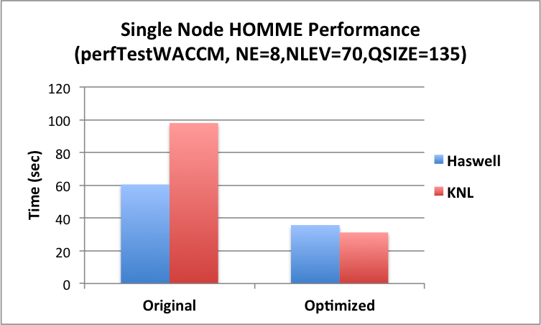
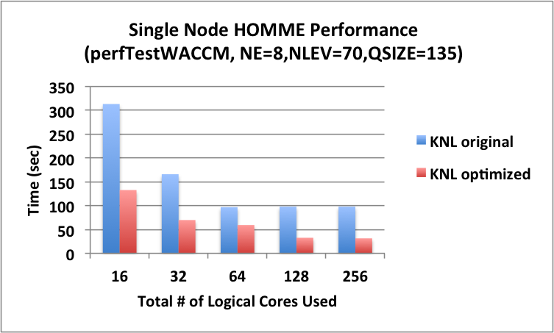
HOMME Single Node Haswell vs. KNL
Haswell: 64 MPI tasks
64-core KNL: 64 MPI tasks, 2x2 nested OpenMP threads
Note: the benchmark is optimized with OpenMP scheme modification olus many other optimization techniques, including loop restructure, cache reuse, vectorization, and MPI optimization.
Helen: this slide can be removed

Slide 77
OpenMP 4 SIMD
Helen note: will most likely delete this slide. This is used in MG2, but will cover SIMD in VASP too.
Parallelize and Vectorize:
Fortran: !$OMP do simd [clauses]
The loop is first divided across a thread team, then subdivide loop chunks to fit a SIMD vector register.
SIMD Functions:
Compilers may not be able to vectorize and inline function calls easily.
Compilers #pramga declare simd tells compiler to generate SIMD function
Useful to use “declare simd” for elemental functions that are called from within a loop, so compilers can vectorize the function.
C/C++:
#pragma omp declare simd
float min (float a, float b) {
return a<b ? a:b;
}

Slide 78
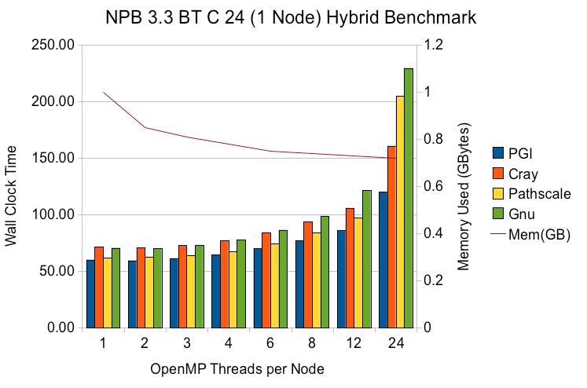
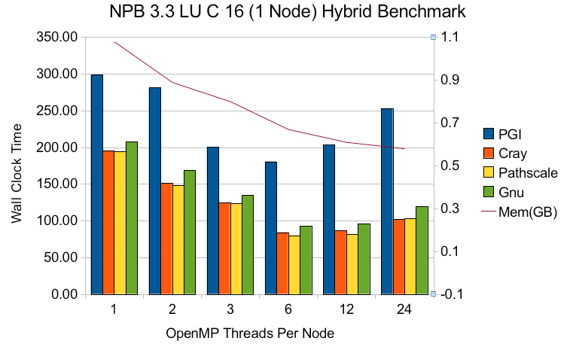
NPB: Hybrid MPI/OpenMP on Hopper
Helen: consider to remove this slide. Old Hopper result, but illustrates the point
Courtesy of Mike Stewart, NERSC
On a single Hopper node (4 NUMA domains, 6 cores each)
Reduced memory footprint with increased OpenMP threads
Hybrid MPI/OpenMP can be faster or comparable to pure MPI
Try different compilers
Sweet spot: BT: 1-3 threads; LU: 6 threads

Slide 79
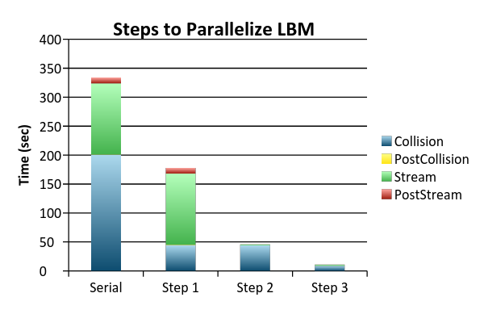
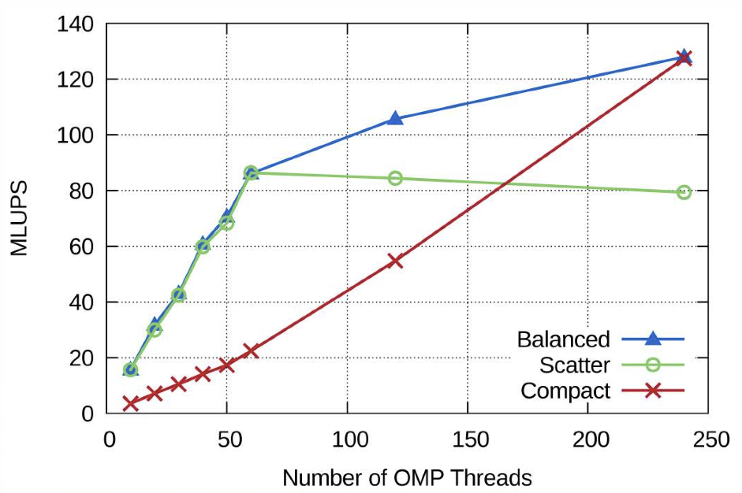
LBM: Add OpenMP Incrementally
Helen: consider to remove this slide. Older result, but illustrates simple point
Compare OpenMP Affinity Choices
Courtesy of Carlos Rosale, TACC
Lattice Boltzmann Method: a Computational Fluid Dynamics Code.
Actual serial run time for Collision > 2500 sec (plotted above as 200 sec only for better display), > 95% of total run time.
Step 1: Add OpenMP to hotspot Collision. 60X Collision speedup.
Step 2: Add OpenMP to the new bottleneck, Stream and others. 89X Stream speedup.
Step 3: Add vectorization. 5X Collision speedup.
Balanced provides best performance overall.

Slide 80
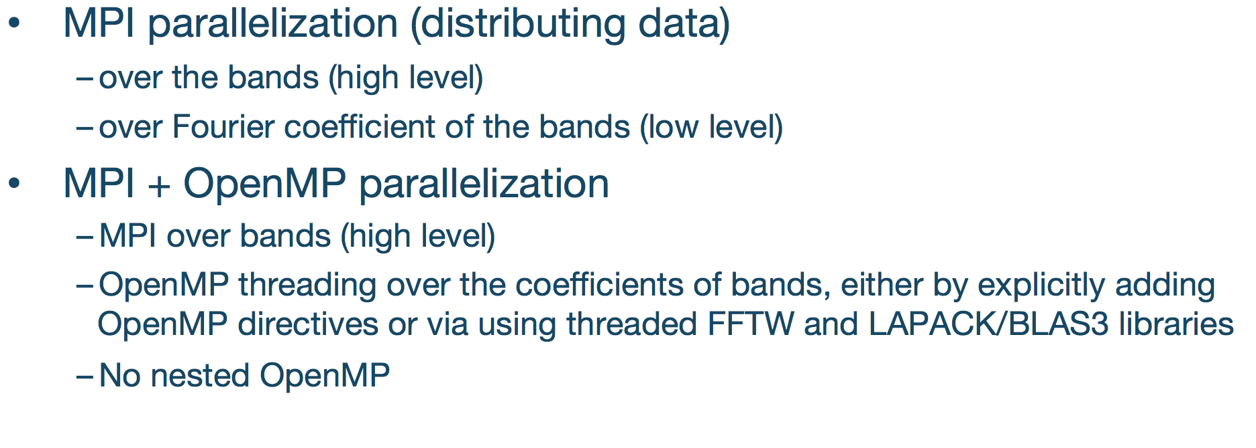
VASP

Slide 81
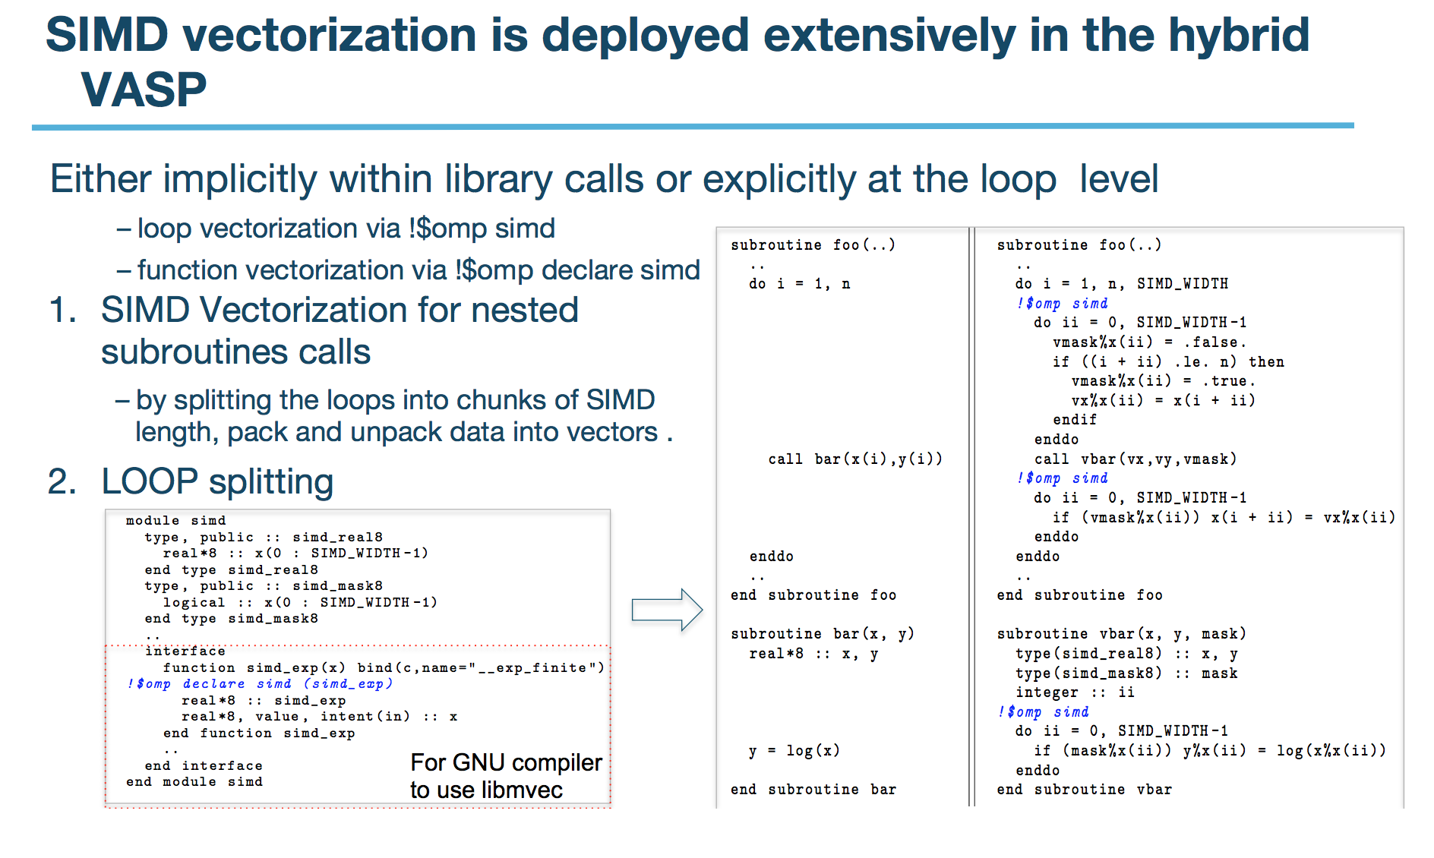
VASP

Slide 82
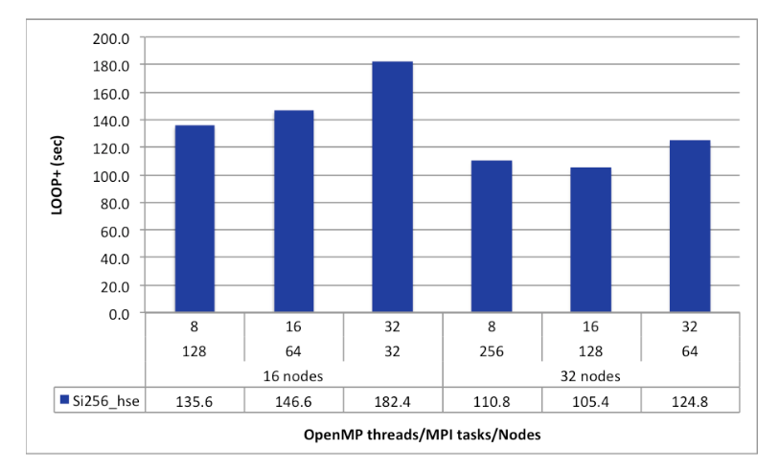
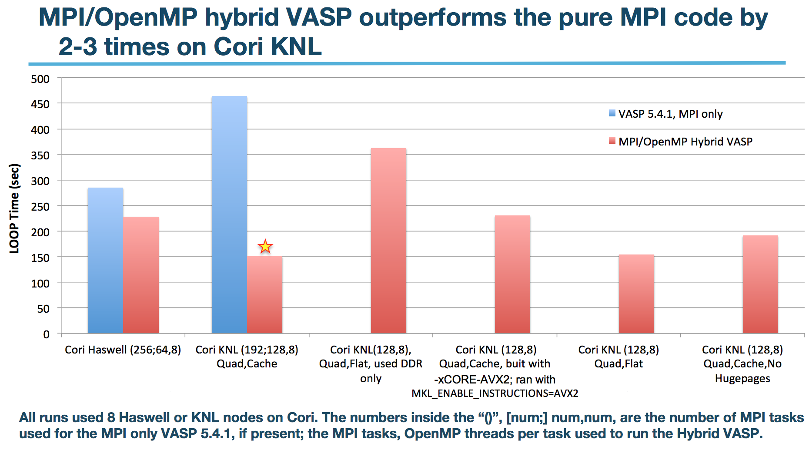
VASP MPI/OpenMP Scaling

Slide 83
MPAS-O: Tasking
Helen: consider to remove this slide. Older result, but illustrates simple point
MPAS-O model uses unstructured meshes, data stored in memory is unstructured. Next contiguous element in an array may not be a neighbor of the previous element. Elements are decomposed into blocks.
Threaded Block Loops: OpenMP Tasking
block => domain % blocklist
do while (associated(block))
call compute_block(block)
block => block % next
end do
block => domain % blocklist
do while (associated(block))
block_d = block
!$omp task
firstprivate(block_d)
call compute_block(block_b)
!$omp end task
block => block % next
end do
!$omp taskwait
Courtesy of Douglas Jacobsen et. al., NCAR Multi-Core 2015 Workshop
Notes:
MPAS-O: Model for Prediction Across Scale -- Ocean

Slide 84
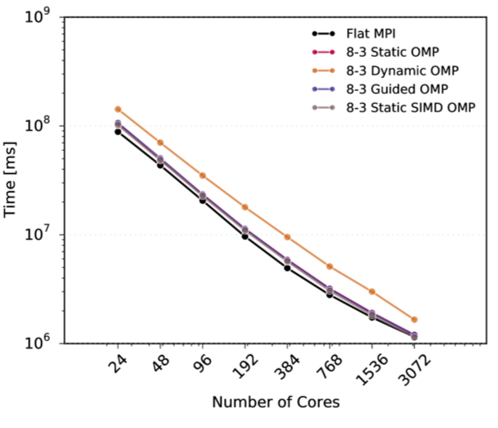
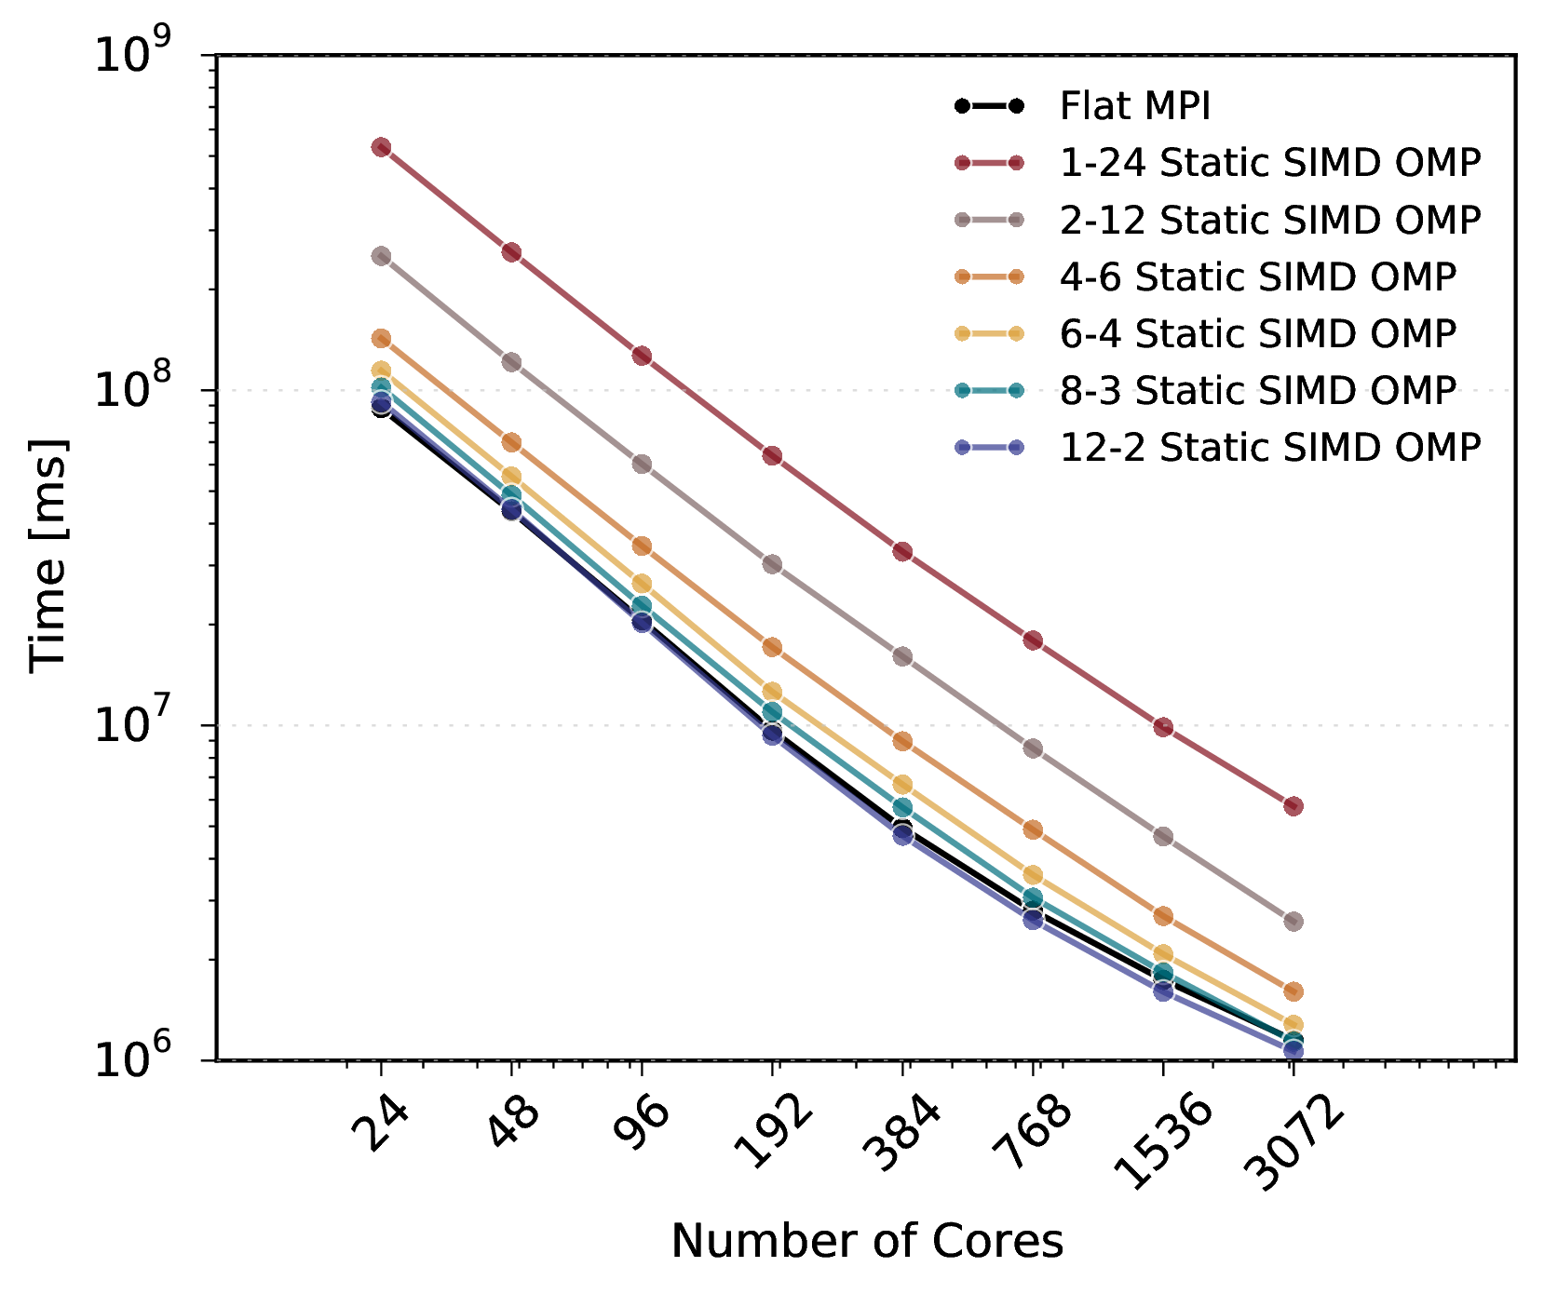
MPAS-O: Compare Schedules and SIMD
Helen: consider to remove this slide. Older result, but illustrates simple point
Good to explore different OpenMP schedules
Good to experiment with different combinations of MPI tasks and OpenMP threads to find a sweet spot. “2-12 Static SIMD OMP” is the best in this case.
SIMD directive helps a little, to vectorize loops compilers can not auto-vectorize.
Courtesy of Douglas Jacobsen et. al., NCAR Multi-Core 2015 Workshop

Slide 85
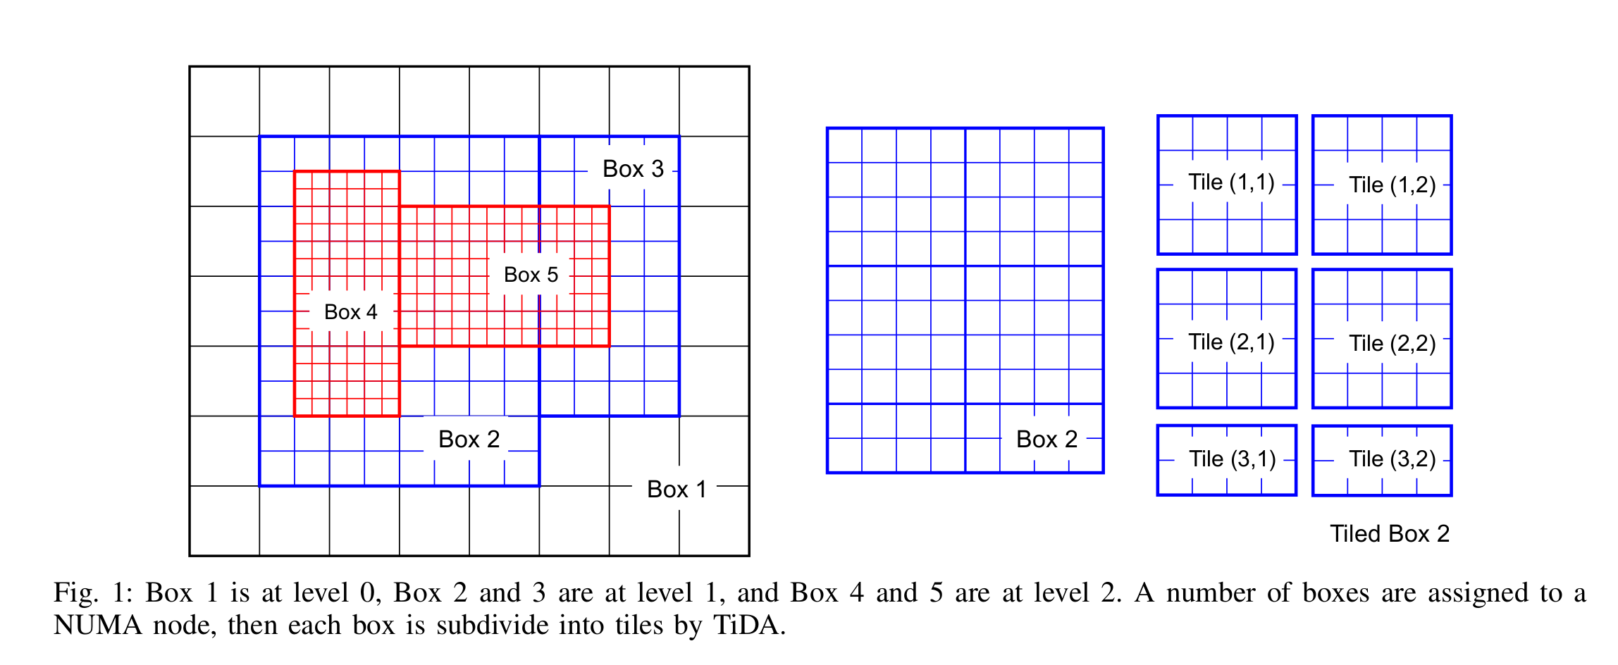
BoxLib: Tiling Threading Model
Helen note: most likely delete this slide.
Use Nyx case study instead
Traditional threading model
Domain decomposed into N boxes, distributed among M MPI tasks, each with m threads.
Load imbalance especially in AMR applications due to uneven workload among MPI tasks
Fine grain OpenMP
Tiling threading model
Iteration space within each box is divided into smaller “tiles”, which are distributed among threads
Better load balancing
Tile size can be tuned for optimal cache reuse.
Coarse grain OpenMP
Many such regions as below:
!$OMP parallel do private (i)
do j=1,15
do i =1,16
… some work here …
end do
end do
!$OMP end parallel do
!$OMP parallel
loop over tiles
get tile box
… some work here …
end loop over tiles
!$OMP end parallel
Courtesy of Brian Friesen, NERSC and Jessica Kawana, Williamette University

Slide 86
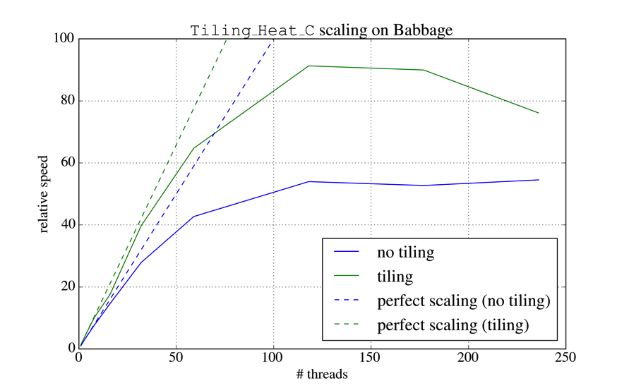
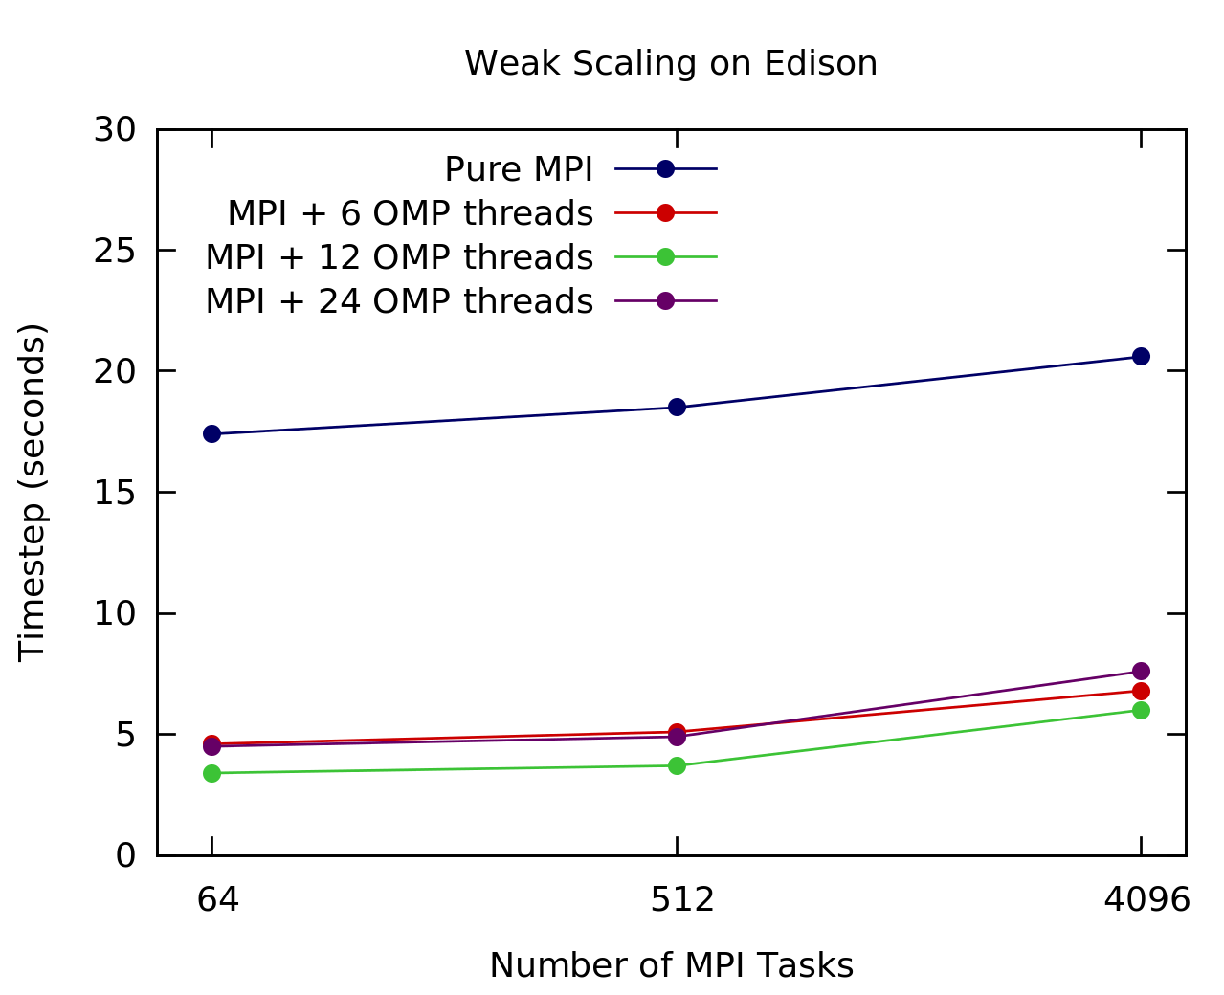
BoxLib: OpenMP and Hybrid MPI/OpenMP Scaling with Tiling
Helen note: most likely delete this slide.
Use Nyx case study instead
Tiling implementation strong scales efficiently up to ~120 threads on Babbage.
For simple operators, tiling is always a win.
For complicated operators (e.g., low Mach number flows), results are mixed.
Best performance with MPI+12 OpenMP threads
Courtesy of Brian Frieson., NERSC

Slide 87
Nyx, a PDE/Stencil Code
Old approach to OpenMP parallelism
Collapse outermost loops
!$omp parallel do collapse(2)
do k = zlo, zhi
do j = ylo, yhi
do i = xlo, xhi
! do work
end do
end do
end do
Non-invasive code change, but memory bandwidth on DDR3/DDR4 begins to saturate at ~5 threads
Not a viable solution for KNL with O(100) threads, even with MCDRAMOpe
Poor cache reuse: 7-point stencil can require ~6 separate cache line loads from DRAM, especially if (x,y,z) loop has long strides
rho(i,j,k) = phi(i-1,j,k,n) + phi(i+1,j,k,n)
+ phi(i,j-1,k,n) + phi(i,j+1,k,n)
+ phi(i,j,k-1,n) + phi(i,j,k+1,n)
Cache line load; no cache line load
Notes:
Red indicates a likely cache line load

Slide 88
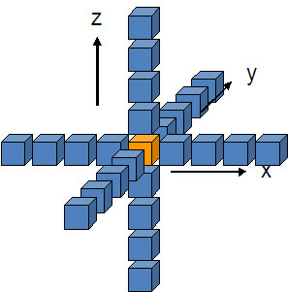
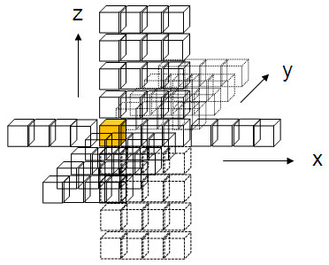
Nyx: New OpenMP Scheme
Loop tiling with OpenMP
Instead of collapsing iteration space, rearrange it to facilitate better cache reuse
What shape is best for tiles?
Long in stride-1 direction (x-axis in Fortran)
Projection of tile onto plane normal to stride-1 axis should encompass the stencil projected onto same plane
E.g., y-z plane projection of nearest-neighbor 7-point stencil has “radius” of 3
Tile shape for 7-point stencil should be (long) x 3 x 3
Can be larger in y-z plane if cache can hold it all (although I don’t know why one would want to do that)

Slide 89
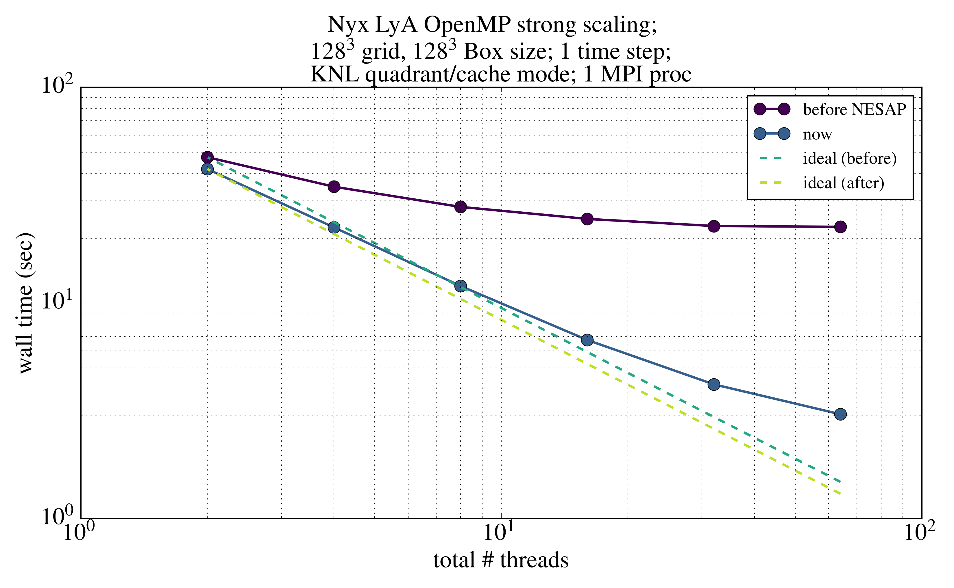
Nyx: Tiling effects (KNL)
Notes:
The uncore counters for byte movement in VTune gives weird results when running in flat mode entirely out of HBM, or in cache mode (i.e., at least 1 OoM smaller than bytes reported when running entirely out of DRAM). So I got these byte numbers from running entirely out of DRAM. Also the AI seems to be much lower (by 30%) vs IVB. The hot kernels in Nyx are well vectorized so AVX512 will generate longer and fewer SIMD instructions. Does SDE count those differently or something?

Slide 90
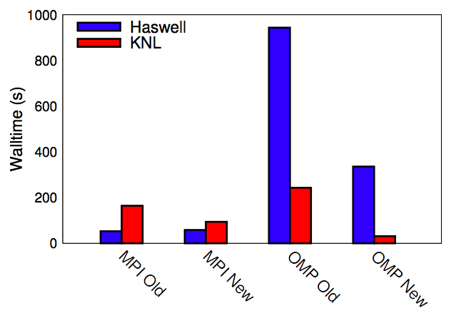
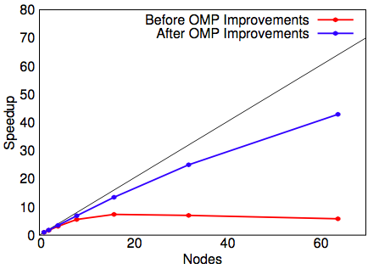
Quantum Espresso: Improved OpenMP Thread Scaling on KNL
Improved OpenMP thread scaling by moving OpenMP to outer regions of the code and by threading multiple FFTs simultaneously.
Using the improved OpenMP code is the fastest way to run on KNL, and is about 2x faster than the best Haswell walltimes.
Courtesy of Taylor Barnes, NERSC

Slide 91
Example - Quantum ESPRESSO Optimizations
DO j=1, n
…
!$omp parallel do …
DO ir=1, nr
rho(ir,j)=conjg(psi(ir,j))
* psi(ir,i)
ENDDO
!$omp end parallel do
…
ENDDO
nblock = 2048
nrt = nr / nblock
!$omp parallel do collapse(2)…
DO ist = 1, nrt
DO j=1, n
ir_start = (irt - 1) * nblock + 1
ir_end = min(ir_start+nblock-1,nr)
DO ir = ir_start, it_end
rho(ir,j)=conjg(psi(ir,j)) * psi(ir,i)
ENDDO
ENDDO
ENDDO
!$omp end parallel do
move OpenMP into the outer loops to create enough work for threads
problem: with collapse(2), many scatter-gather instructions generated (compiler bug?)
solution: manual blocking/tiling
DO j=1:n
…
DO ir=1:nr
…
ENDDO
…
FFT[…]
…
DO ir=1:nr
…
ENDDO
…
IFFT[…]
…
ENDDO
DO j=1:n
…
DO ir=1:nr
…
ENDDO
…
ENDDO
FFT_MANY[…]
DO j=1:n
…
DO ir=1:nr
…
ENDDO
…
ENDDO
IFFT_MANY[…]
DO j=1:n
…
ENDDO
Courtesy of Brian Frieson., NERSC

Slide 92
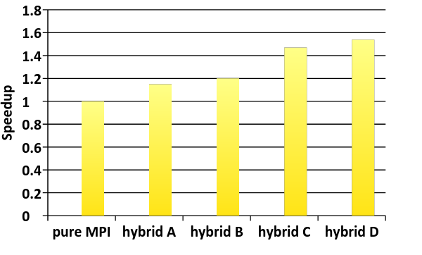
MFDn: Overlap Comm and Comp
Helen: consider to remove this slide. Old Hopper result, but very classic. Also has Kevin’s case study next
!$OMP PARALLEL
if (my_thread_rank < 1) then
call MPI_xxx(…)
else
do some computation
endif
!$OMP END PARALLEL
Need at least MPI_THREAD_FUNNELED.
While master or single thread is making MPI calls, other threads are computing!
Must be able to separate codes that can run before or after halo info is received. Very hard!
Lose compiler optimizations.
Courtesy of H. M. Aktulga et. al.
MFDn: a nuclear physics code.
Hopper. Pure MPI: 12,096 MPI tasks.
Hybrid A: hybrid MPI/OpenMP, 2,016 MPI* 6 threads.
Hybrid B: hybrid A, plus: merge MPI_Reduce and MPI_Scatter into MPI_Reduce_Scatter, and merge MPI_Gather and MPI_Bcast into MPI_Allgatherv.
Hybrid C: Hybrid B, plus: overlap row-group communications with computation.
Hybrid D: Hybrid C, plus: overlap (most) column-group communications with computation.

Slide 93
Overlap Computation and communication: mpi_thread_multiple. (Kevin)
!$OMP PARALLEL
if (my_thread_rank < 1) then
call MPI_xxx(…)
else
do some computation
endif
!$OMP END PARALLEL
Need at least MPI_THREAD_FUNNELED.
While master or single thread is making MPI calls, other threads are computing!
Must be able to separate codes that can run before or after halo info is received. Very hard!
Lose compiler optimizations.

Slide 94
OpenMP tasking (Bill biology code)

Slide 95
Current and Future Direction of OpenMP
Barbara Slides

Slide 96
Overview: OpenMP 4.5 Update
Released at SC’15
Many refinements to device support
Clarifications and minor enhancements, including:
Reductions for C/C++ arrays
Runtime routines to support cancelation and affinity
Some new features have been added
Support for doacross loops
Divide loop into tasks with taskloop construct

Slide 97
OpenMP 4.5 substantially improves device support
Unstructured data mapping
Asynchronous execution
Scalar variables are firstprivate by default
Device runtime routines: allocation, copy, etc.
Clauses to support device pointers
Ability to map structure elements
New combined constructs
New way to map global variables (link)

Slide 98
OpenMP 4.5 has many other refinements to recent additions
Many clarifications and minor enhancements
SIMD extensions
SIMD and SIMD parallel loop chunk size control
Addition of schedule modifiers: simd, monotonic, nonmonotonic
Clarifications of thread affinity policies
Grammar for OMP_PLACES
Support for if clause on combined/composite constructs
Hints for locks and critical sections
Continues to increase Fortran 2003 support
Ten limitations remain until 5.0
Task priorities
Improved support for C++ reference types
Compiler support: http://www.openmp.org/resources/openmp-compilers/

Slide 99
OpenMP 5.0 Preview – TR6 released November 2017 Slide Needs to be updated
Major new feature is performance tool support (TR2+) -
Some significant extensions to existing functionality
Support for task reductions, including on taskloop construct
Implicit declare target directives and other verbosity reducing changes
Many clarifications and minor enhancements, including:
Runtime report of actual thread affinity information (Helen added this)
Use of any C/C++ lvalue in depend clauses
Addition of depend clause to taskwait construct
Addition of conditional modifier to lastprivate clause
Permits declare target on C++ classes with virtual members
Clarification of declare target C++ initializations

Slide 100
OpenMP 5.0 will significantly extend TR6 & TR5
Main Topics for 5.0
Memory locality, affinity and working with complex memory hierarchies
Updates to support latest C/C++ standards, completion of Fortran 2003
Continued improvements to device support and tasking, including:
Deep copy for mapped variables; Improved support for multiple devices
Unshackled threads, major extensions for task dependences
Interoperability and composability
Debugging tools support
OpenMP 5.0 is scheduled to be released by SC18
TR6 (TBD – SC’17) will document most additions for 5.0

Slide 101
Memory Management --- TR6 released November 2017
Language features for managing memory on systems with heterogeneous memories.
Main Concepts:
Memory Spaces --- Represents memory resources
Memory Traits --- {Location, Distance, Bandwidth, Latency, Persistence, etc}
Allocator Traits
Allocator and Directives APIs

Slide 102
Help us shape the future of OpenMP
http://openmp-ecp.ornl.gov - Ticket system
Connect with the SOLLVE project --- WBS# 1.3.1.15
Complete our survey on the confluence site!
Application engagement via shared milestones for FY17,18,19
OpenMP continues to grow
28 members currently
You can contribute to our now planned annual TR or complete specification releases
Attend IWOMP, become a cOMPunity member
Become a member in the OpenMP ARB
OpenMP membership types will become more accessible
Please let us know if you would be interested

Slide 103
Extra Slides
Move slides from the deck to here if won’t have time to cover

